Slide 1
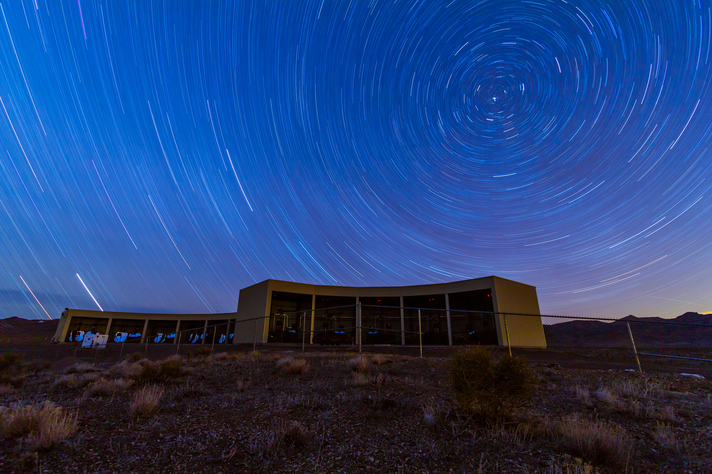
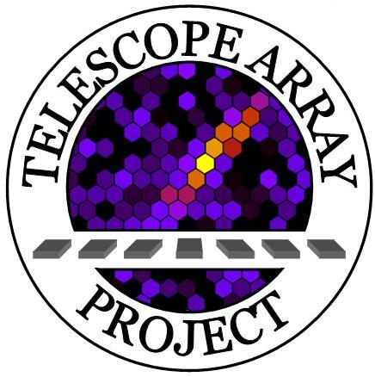
Spectrum Measurement with the Telescope Array Low Energy Extension (TALE) Fluorescence Detector
Zachary Zundel
PhD Defense
Feb 11, 2016

Slide 2
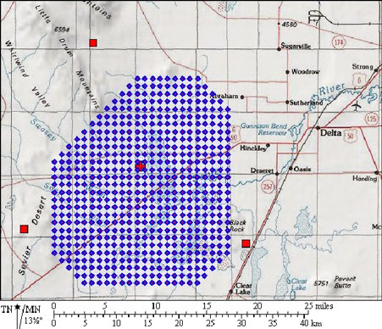
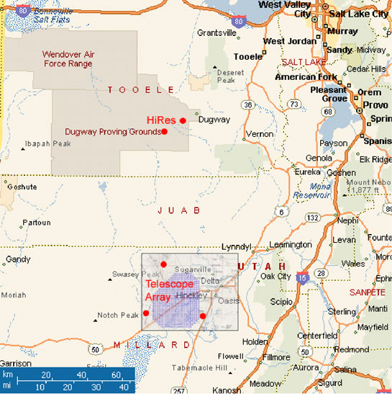
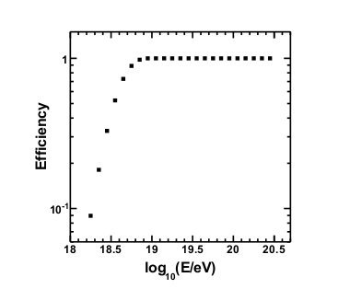
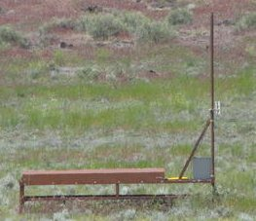
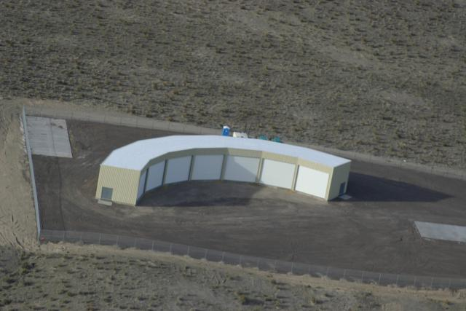
Telescope Array Experiment
Array of 507 Plastic Scintillator Counters
1.2 km spacing
Fully efficient
above 10¹⁹ eV
3 Fluorescence Detector Stations
12 or 14 telescopes per station
View 3°-31° in elevation
Designed for detecting air showers above 10¹⁸ eV
Many Interesting features not in this energy Range
MD/TALE
LR FD
BR FD
Surface Detector Efficiency vs Energy
MD FD Station
TA Surface
Detector

Slide 3
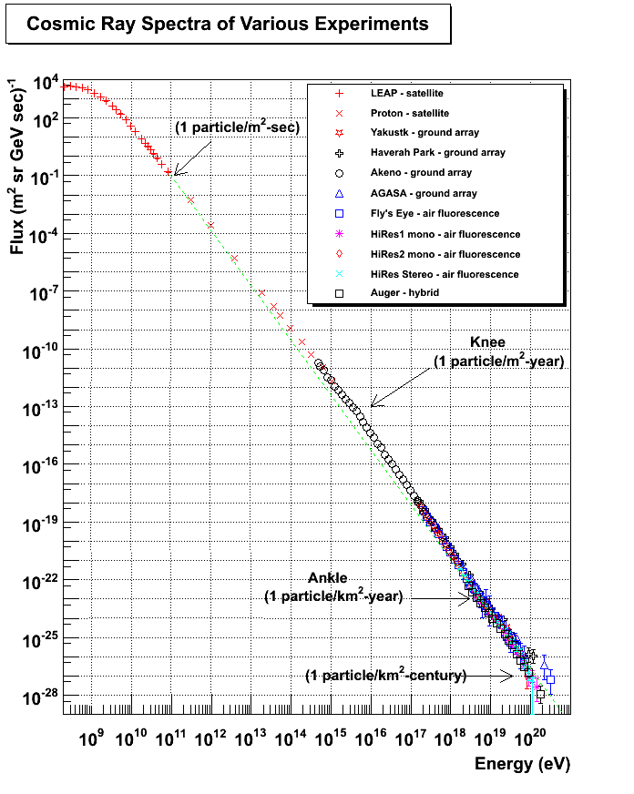
Cosmic Rays
H+, He++,…
Cosmic Rays are charged particles (ionized atomic nuclei, electrons, etc.)
Sources are
Solar
Galactic
Extragalactic
Particles cover 20 decades in energy
Cosmic Rays reach higher energies than any accelerator on the planet
LHC
(14 TeV Center of Mass)
Notes:
"Nucleus drawing" by Marekich - Own work (vector version of PNG image). Licensed under CC BY-SA 3.0 via Wikimedia Commons - http://commons.wikimedia.org/wiki/File:Nucleus_drawing.svg#mediaviewer/File:Nucleus_drawing.svg
Credit: X-ray: NASA/CXC/CfA/R.Kraft et al; Radio: NSF/VLA/Univ.Hertfordshire/M.Hardcastle; Optical: ESO/VLT/ISAAC/M.Rejkuba et al.
http://apod.nasa.gov/apod/ap140712.html

Slide 4
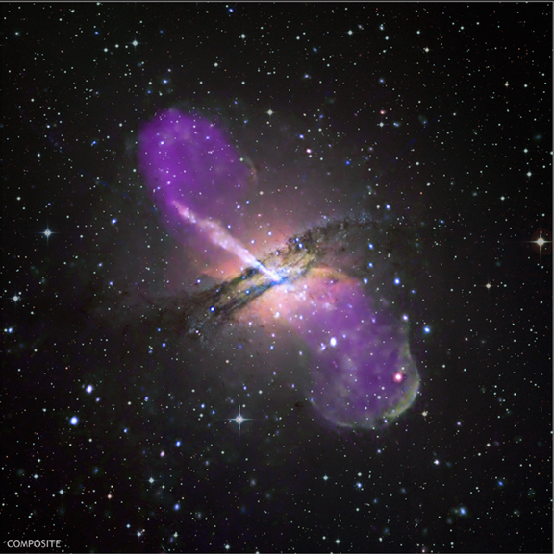
Extragalactic Cosmic Rays
“Hillas Plot”:
Estimate of Maximum Particle Energy
10²⁰ eV proton
Threshold
10¹⁶ eV proton
Threshold
Hillas Plot[High Energy Astrophysics, Longair 3rd Edition]
Notes:
"Nucleus drawing" by Marekich - Own work (vector version of PNG image). Licensed under CC BY-SA 3.0 via Wikimedia Commons - http://commons.wikimedia.org/wiki/File:Nucleus_drawing.svg#mediaviewer/File:Nucleus_drawing.svg
Credit: X-ray: NASA/CXC/CfA/R.Kraft et al; Radio: NSF/VLA/Univ.Hertfordshire/M.Hardcastle; Optical: ESO/VLT/ISAAC/M.Rejkuba et al.
http://apod.nasa.gov/apod/ap140712.html

Slide 5
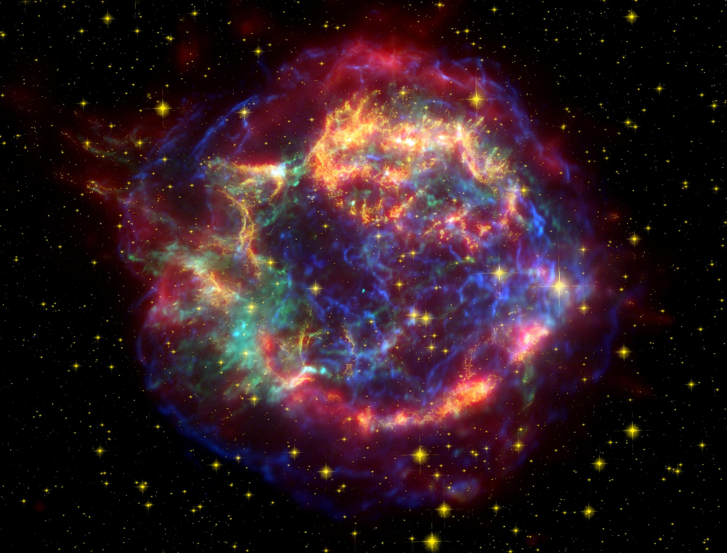
Galactic Sources
SN 1680
11<Log(Energy [eV])<17.5
Supernova Remnants
Example of “modeled” elemental contribution to energy spectrum [High Energy Astrophysics, Longair 3rd Edition]
Notes:
"Crab Nebula NGC 1952 (composite from Chandra, Hubble and Spitzer)" by X-Ray: NASA/CXC/J.Hester (ASU); Optical: NASA/ESA/J.Hester & A.Loll (ASU); Infrared: NASA/JPL-Caltech/R.Gehrz (Univ. Minn.) - http://www.spitzer.caltech.edu/images/2857-sig09-009-NASA-s-Great-Observatories-View-of-the-Crab-Nebula (direct link). Licensed under Public Domain via Wikimedia Commons - http://commons.wikimedia.org/wiki/File:Crab_Nebula_NGC_1952_(composite_from_Chandra,_Hubble_and_Spitzer).jpg#mediaviewer/File:Crab_Nebula_NGC_1952_(composite_from_Chandra,_Hubble_and_Spitzer).jpg
"Tycho-supernova-xray" by NASA/CXC/Rutgers/J.Warren & J.Hughes et al. - http://chandra.harvard.edu/photo/2005/tycho/. Licensed under Public Domain via Wikimedia Commons - http://commons.wikimedia.org/wiki/File:Tycho-supernova-xray.jpg#mediaviewer/File:Tycho-supernova-xray.jpg
"Cassiopeia A Spitzer Crop" by Oliver Krause (Steward Observatory) George H. Rieke (Steward Observatory) Stephan M. Birkmann (Max-Planck-Institut fur Astronomie) Emeric Le Floc'h (Steward Observatory) Karl D. Gordon (Steward Observatory) Eiichi Egami (Steward Observatory) John Bieging (Steward Observatory) John P. Hughes (Rutgers University) Erick Young (Steward Observatory) Joannah L. Hinz (Steward Observatory) Sascha P. Quanz (Max-Planck-Institut fur Astronomie) Dean C. Hines (Space Science Institute) - http://gallery.spitzer.caltech.edu/Imagegallery/image.php?image_name=ssc2005-14c. Licensed under Public Domain via Wikimedia Commons - http://commons.wikimedia.org/wiki/File:Cassiopeia_A_Spitzer_Crop.jpg#mediaviewer/File:Cassiopeia_A_Spitzer_Crop.jpg

Slide 6
Hadron Induced Air shower Illustrative Cartoon: Used To detect cosmic rays with energies greater then 10¹⁵ eV (<1 particle / m² per year)
Target Air Nucleus
Majority of secondary
Particles are pions
Neutral pions seed
electromagnetic cascades

Slide 7
Hadron Induced Air shower Illustrative Cartoon: EM Cascading process continues until the average particles ionization loss become greater than Bremstrahlung loss Creates majority of secondary measurable particles
Target Air Nucleus
Neutral pions seed
electromagnetic
cascades

Slide 8
Hadron Induced Air shower Illustrative Cartoon:
Target Air Nucleus
Low energy charged pions generated high in the atmosphere can decay

Slide 9
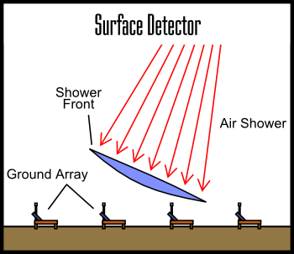
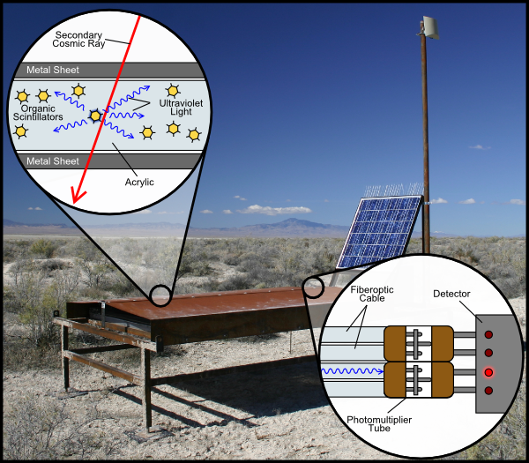
Surface Detectors
Direct Detection of Air Shower Particles
Event energy reconstruction highly dependent on Monte Carlo expectations
Large Duty Cycle (~99%)

Slide 10
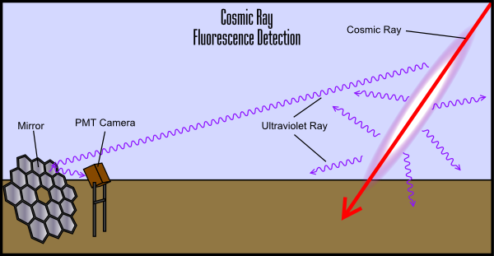
FD Air Shower Detection
Indirect Detection
Nitrogen Fluorescence
Small Duty Cycle (10%) clear moonless nights.
Direct Calorimetric measurement

Slide 11
Cosmic Ray Observatory Measurements
Things that are measured
Cosmic Ray Energy
Spectrum Measurement
Cosmic Ray nuclei type
Chemical composition of Primary Cosmic Ray
Heavier elements interact earlier in the atmosphere and reach their shower maximum faster
Direction of the Cosmic Ray Arrival
Anisotropy
This
Dissertation

Slide 12
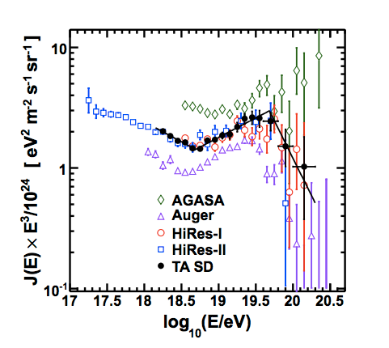
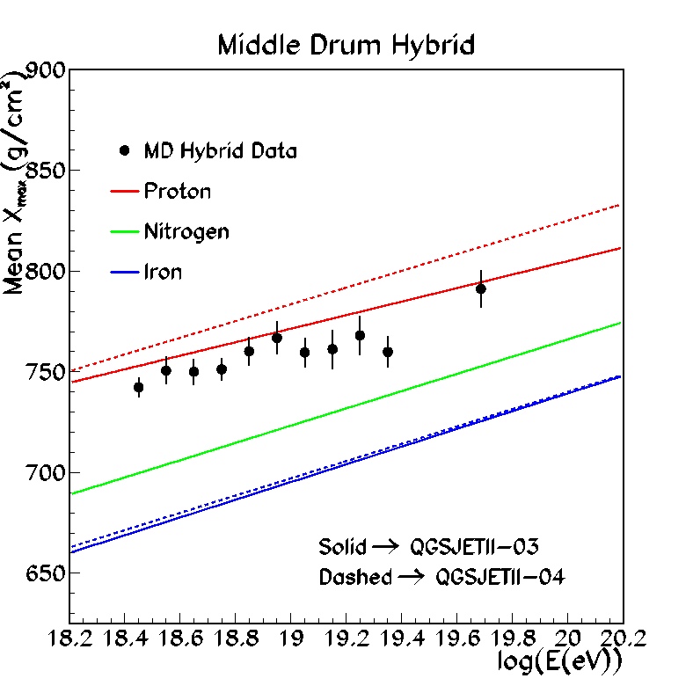
Telescope Array Experimental Results
Suppression of cosmic ray flux above 10^{19.6} eV
Light Composition
Consistent With GZK interpretation (Interaction with CMB)
TA SD Spectrum Measurement
MD HYBRID Chemical Composition
Proton
Expectation
Iron
Expectation

Slide 13
Telescope Array Results
Feature in the spectrum that may
Indicate proton primaries
Predicted Spectrum due to:
Isotropic proton source at various redshift
GZK Interaction (e⁺ e⁻ pile up)

Slide 14
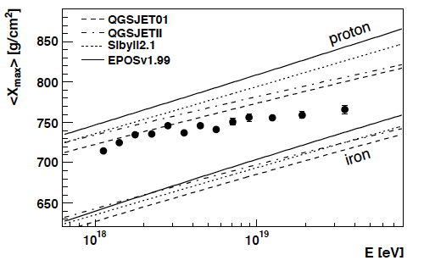
Auger (Southern Hemisphere)
Also See Suppression
Believe due to acceleration termination
AUGER
Heavier Composition than TA

Slide 15
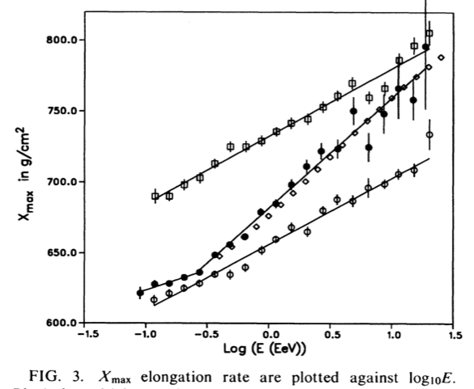
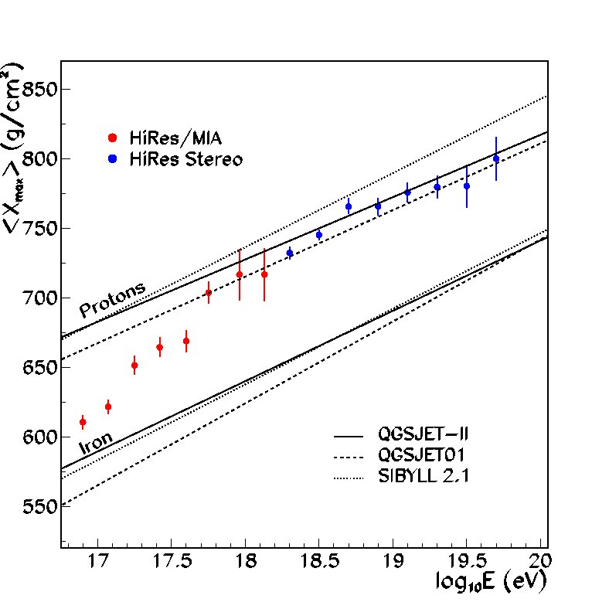
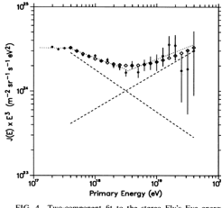
Cosmic Ray Galactic to Extragalactic Transition
Fly’s Eye
HiRes
Fly’s Eye 1986-1992
Change in composition at 10^{18.5} eV
Simultaneous spectrum and composition fit
High Resolution Fly’s Eye (HiRes) 1994-2006
Better Systematics
Better Xmax resolution
35g/cm² vs 55g/cm²
Change in composition measured at 10^{17.5}
Lower end of HiRes sensitivity
Higher end of MIA sensitivity
Measure Transition at lower
Energy than Fly’s Eye
HiRes Stereo and HiRes/Mia
Do Not Overlap
}

Slide 16
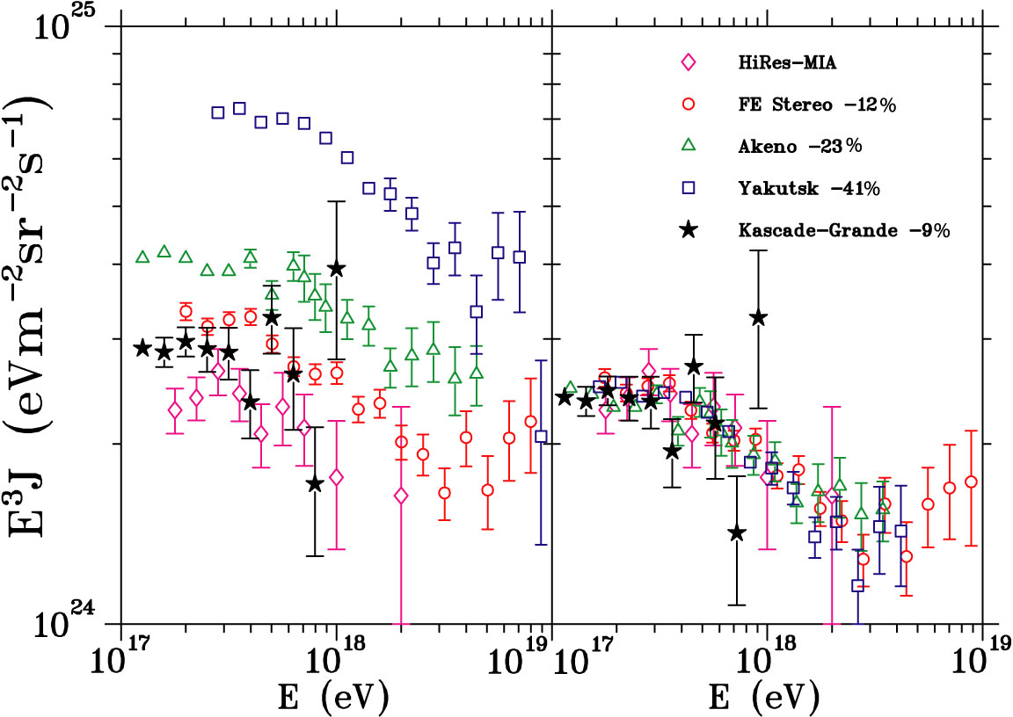
Second Knee
Inferred by the combined measurement of many experiments
Different Energy Scales
Consistent with HiRes composition change
Need simultaneous spectrum and composition measurement
No Single Experiment claims Measurement
Location of break lost due to energy rescaling

Slide 17
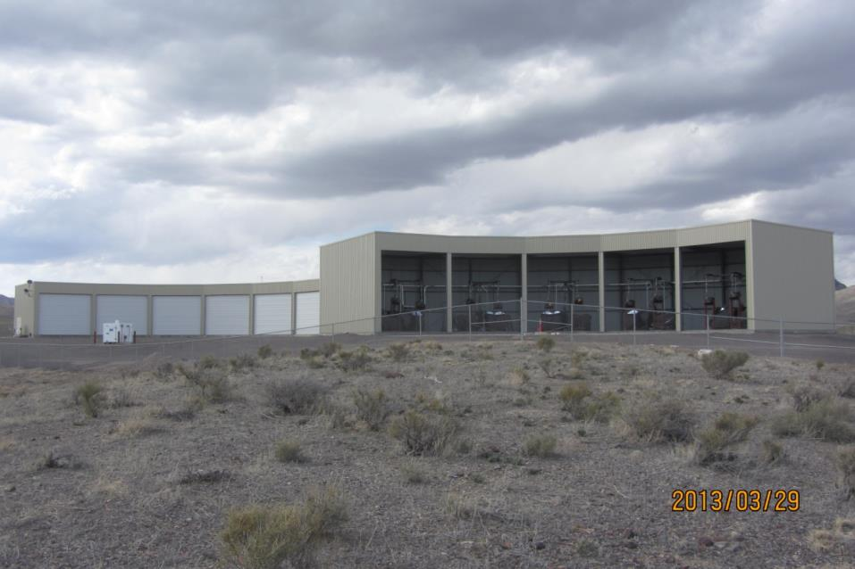
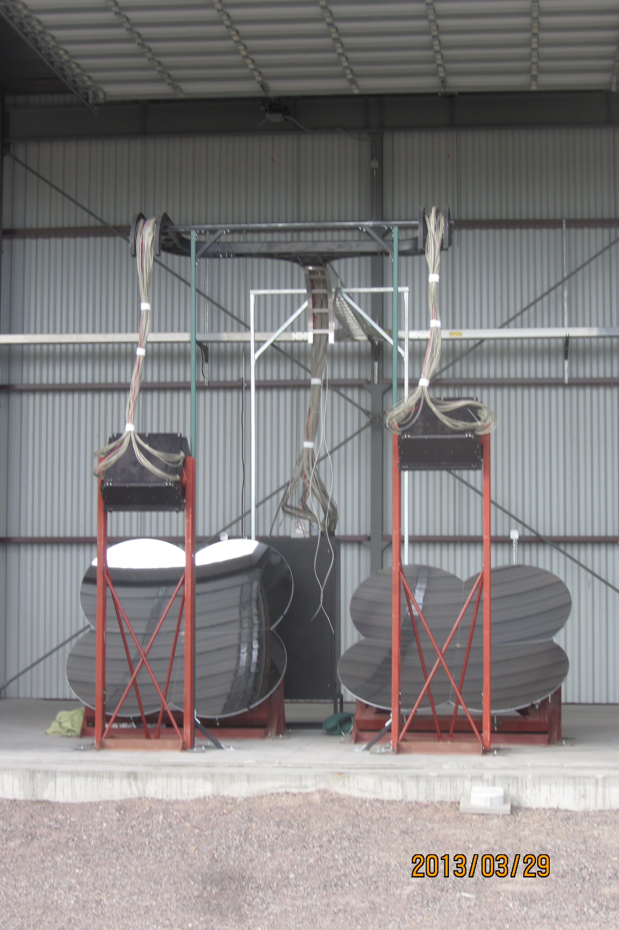
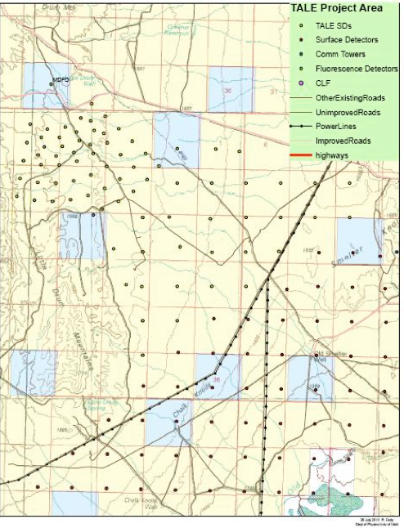
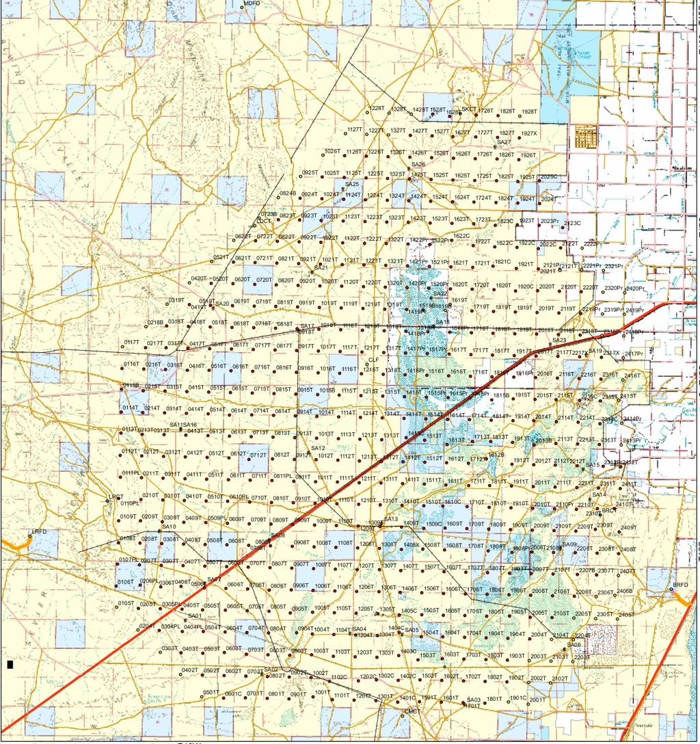
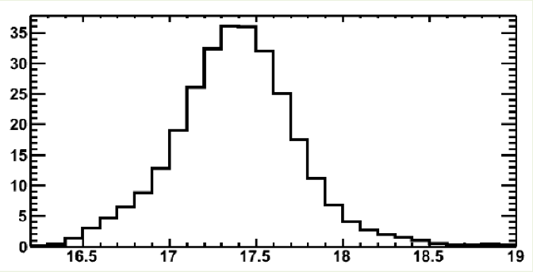
Telescope Array Low Energy Extension (TALE)
TALE BUILDING
Second Knee Observation
Spectrum measurement
Composition Measurement
Overlaps with MD
Surface Detectors
Graded Infill Array
0.4km, 0.6km and 1.2km spacing
Fluorescence Detectors
10 Telescopes
Covering 31-59 degrees
Sensitive from 10^{16.5} to 10^{18.5}
TALE and MD FD
Middle Drum FD
700 km²
Hybrid Sensitivity
Long Ridge FD
Monte Carlo:
Hybrid Sensitivity
Black Rock FD
Number of Events
log(Energy [eV])

Slide 18
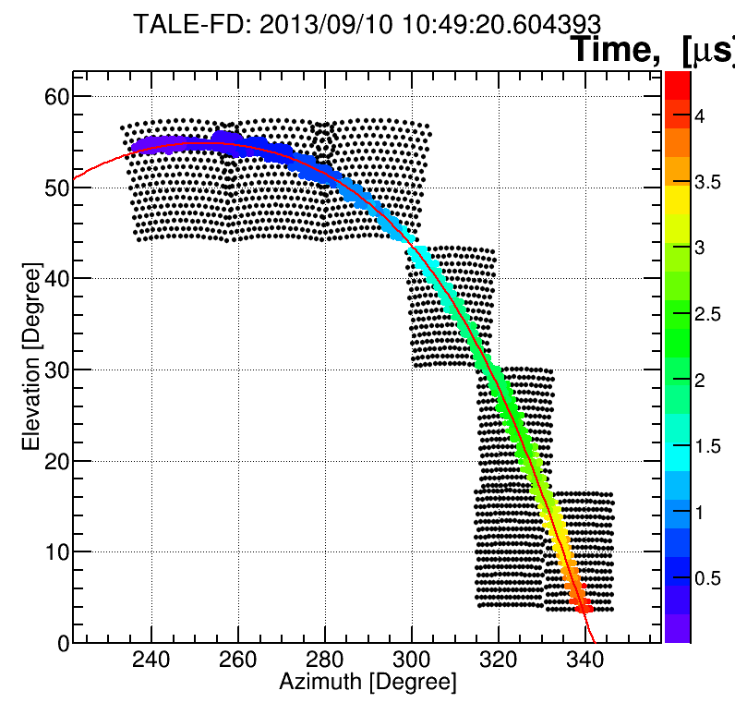
TALE FD (This Dissertation)
Instrument and deploy the TALE fluorescence detector
Resolve any operational obstacles
Lower the TA energy threshold to 10^{16.5} eV
Measure the the cosmic ray spectrum from 10^{16.5}-10^{18.5} eV
TALE
Cherenkov “BLAST”
MD
TALE Above MD Field of View

Slide 19
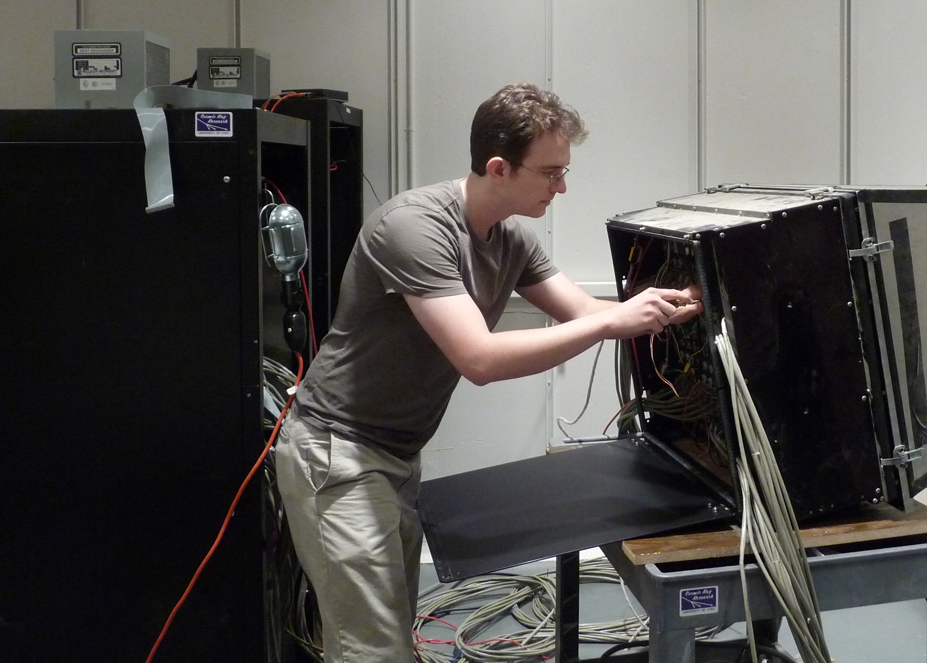
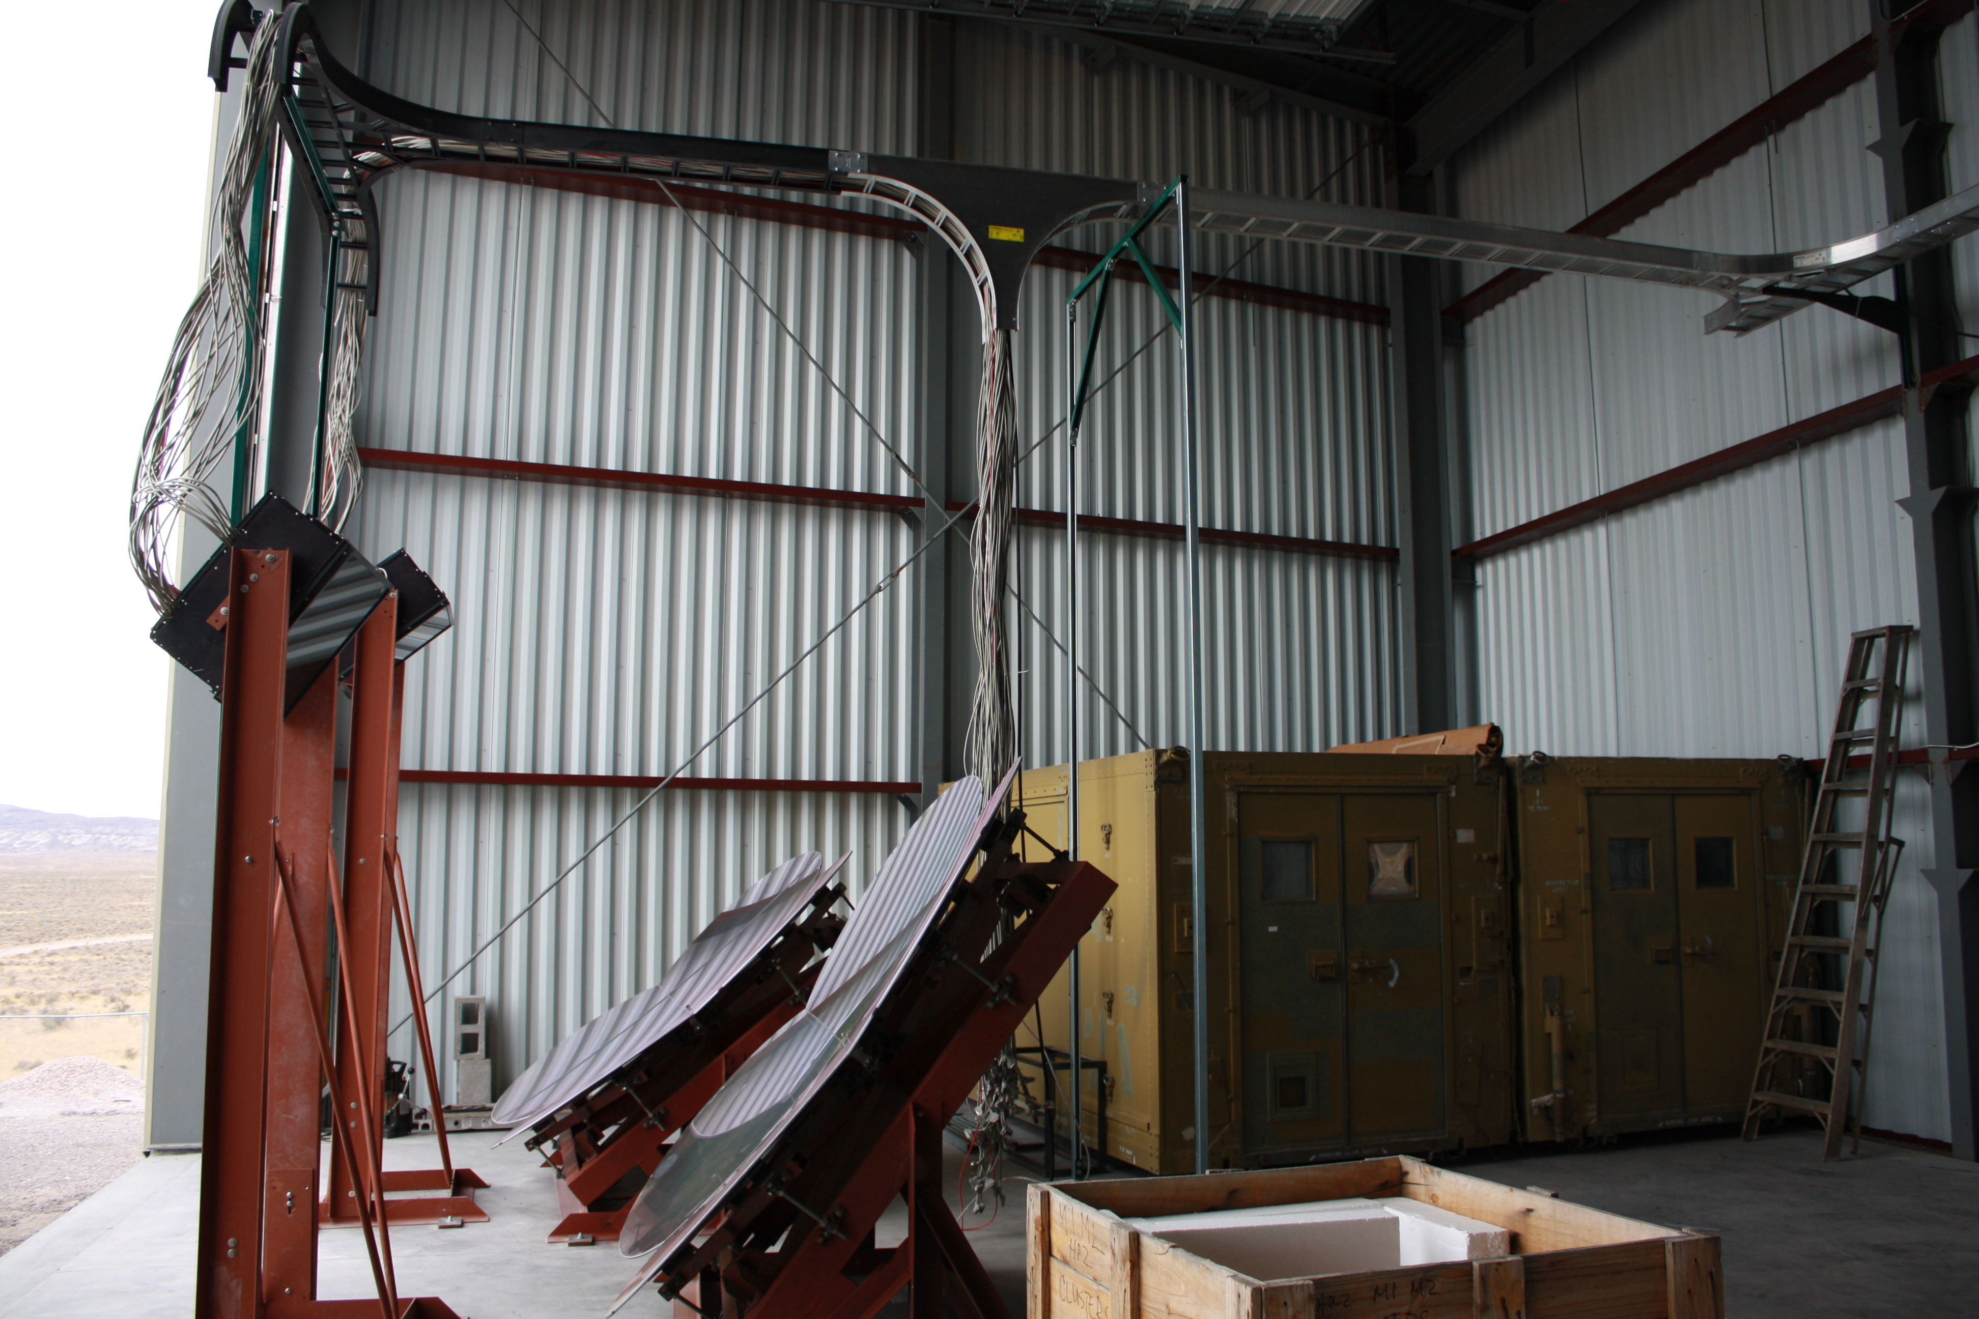
TALE Instrumentation (10 Telescopes)
2009-2013
Jeremy Smith (Electrical Engineer) and myself
Refurbishment of HiRes-II Components
Develop new Link System
Redesigned for Higher Data Rate

Slide 20
TALE DATA Collection Periods
This Dissertation
Epoch | Period | Notes
1 | Sept 2013 – Jan 2014 | Stable Operation. Tube gain ~0.6 ADC/NPE
2 | Jan 2014 – June 2014 | Unstable Testing Period
3 | June 2014 - Current | Stable operation. Tube gain ~1.0 ADC/NPE
Bug in calibration lead Epoch 1 low gain - Reduced aperture of detector
Stable Data Set for detector evaluation
Data set to validate the detector
“Close The Loop”
Epoch 3 : High Statistics Data Set

Slide 21
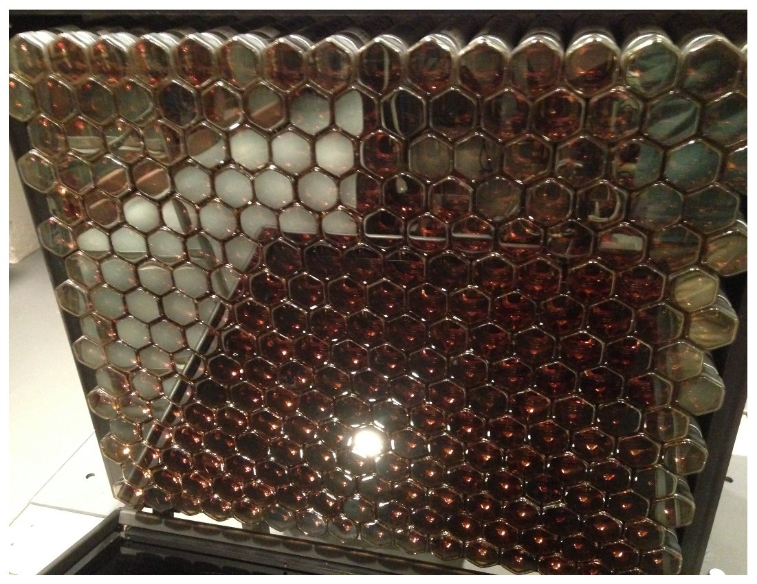
Example of a TALE telescope
Telescope Mirror
PMT Camera Cluster
Electronics Crate
Light collected by mirror
Focused onto PMT Camera
PMT Signals read out by electronics rack

Slide 22
TALE Communication Structure: Star Pattern
Allows Higher Data Rate
Than HiRes-II Ring Network
Operator Linux PC
(MDRUN)
FADC Boards
FADC Boards
Trigger
Board
Central Timing
Comm.
Trigger
Board
Rack
Control
Module
Rack
Control
Module
Individual Camera Bandwidth:
10 Mbytes/Sec
Trigger
Board
Trigger
Board
FADC Boards
FADC Boards
New Mirror Link Modules

Slide 23
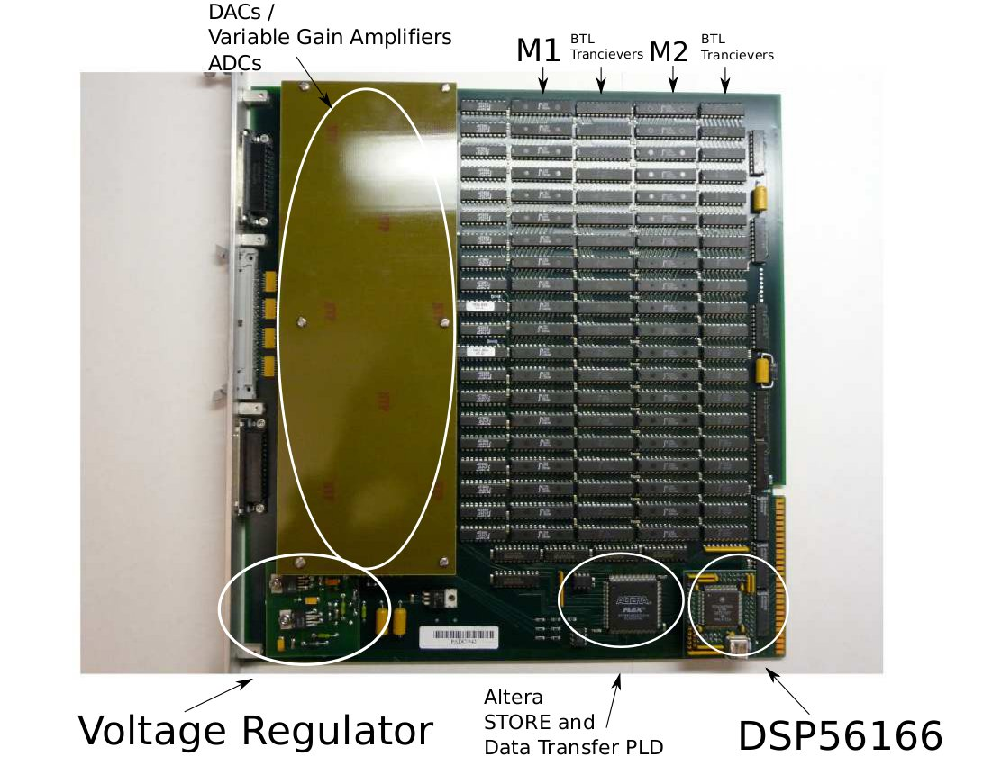
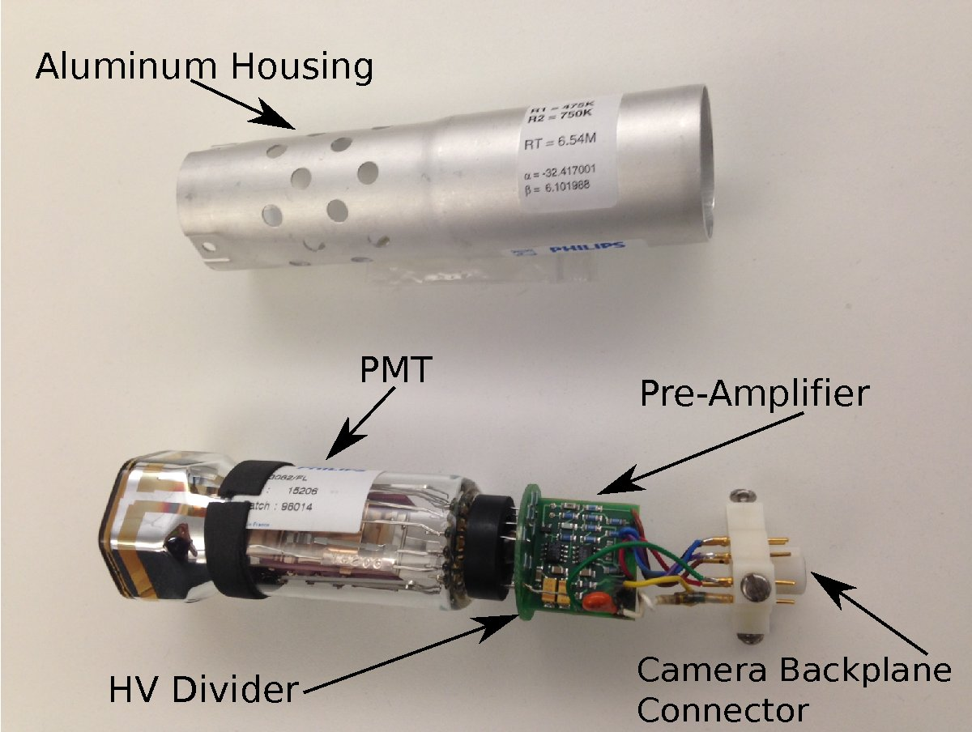
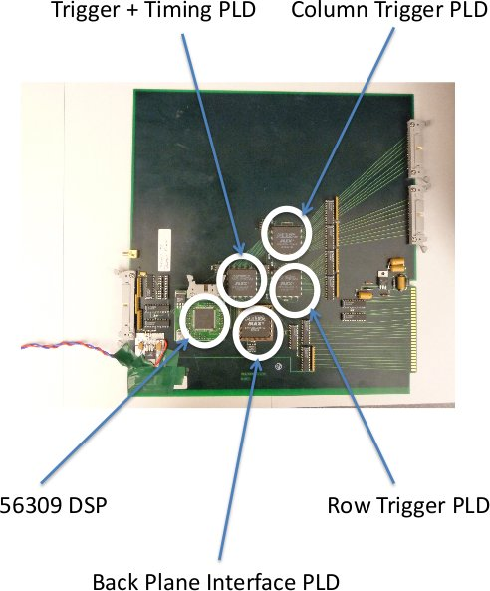
2009-2013 Development and integration of detector components
Major part of the Research Work was Hardware Development
FADC Digitizes Waveforms
Phototube coverts light
to electrical signal
Trigger Board Determines Readout
Link Network handles
communication and control
Data is stored on the control PC

Slide 24
Example Pulse
Anti-aliasing Filter
spreads out pulse
Pedestal
Muon Passing through Dynodes of PMT

Slide 25
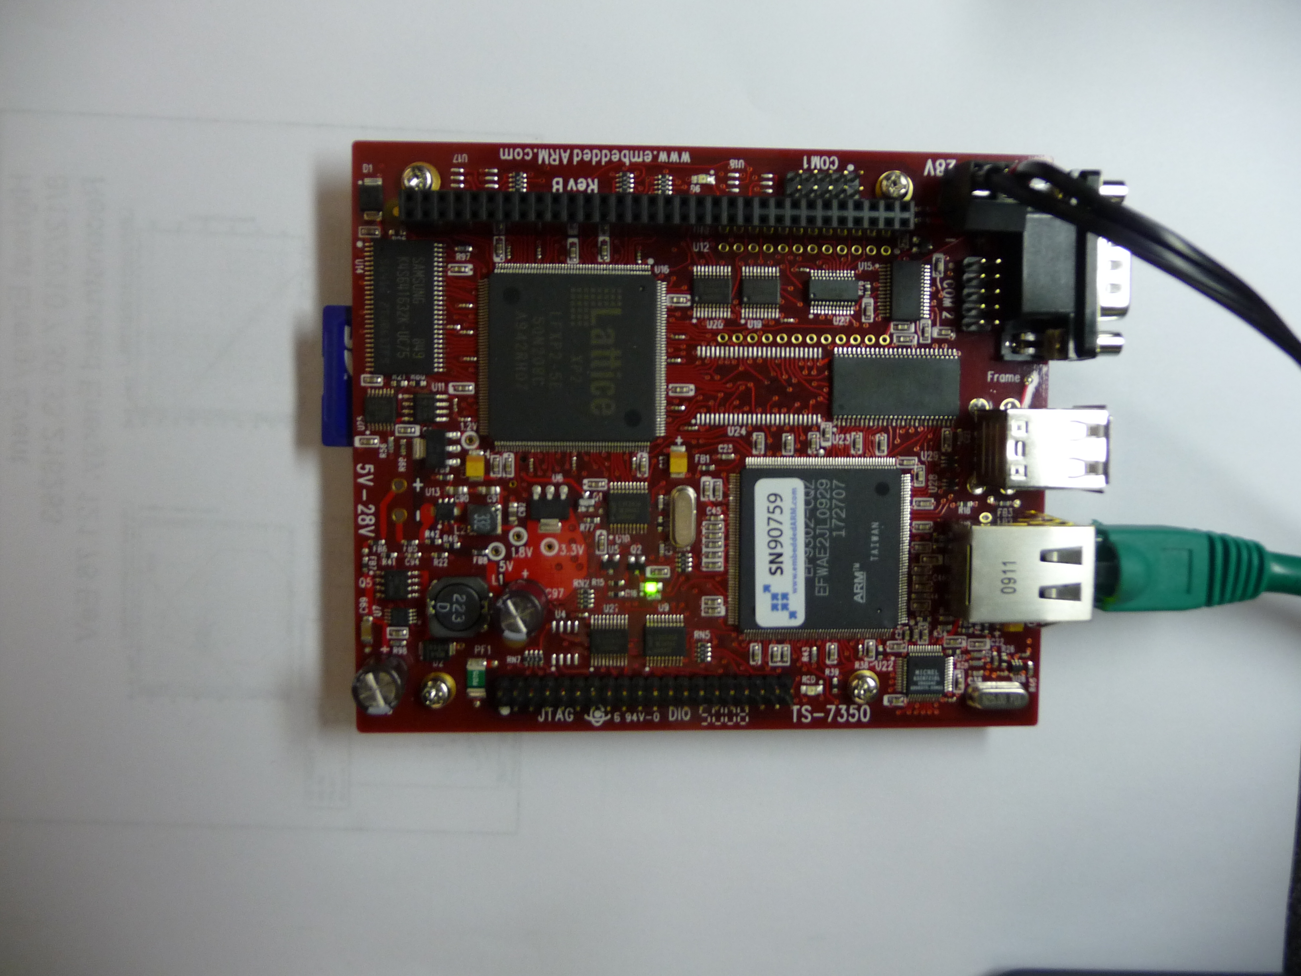
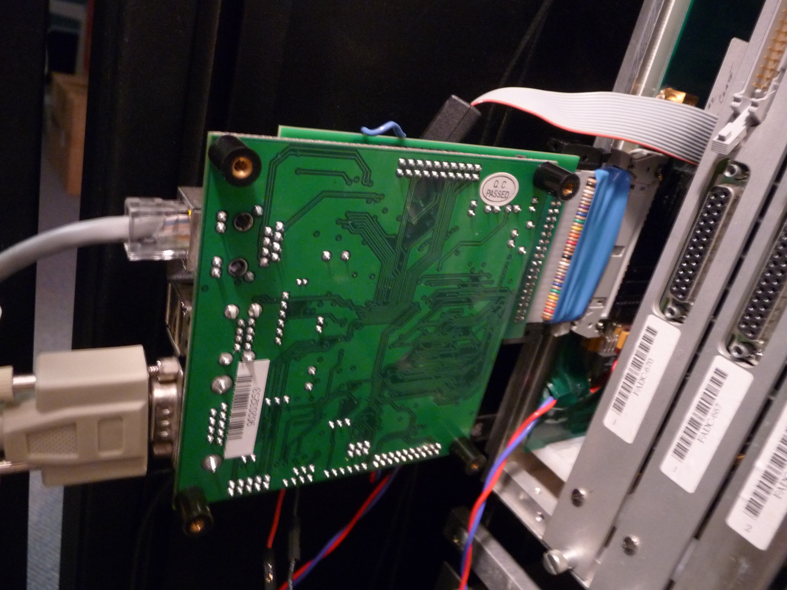
Develop New Link Modules
Handles Communication to Host/Trigger Boards and control PC
Provide interface to Central Timing via a custom CPLD board
Link Modules
HV
HV
Glomation development board
FADC x16
TS-7350 PC104 Bus:
12MByte/sec Data Rate
200MHz ARM9 CPU
32MB SDRAM (64-128MB opt)
Flexible 64-pin FPGA-PC/104 connector
1 10/100 ethernet port
5K LUT FPGA
8MB RAM Framebuffer, no video core
2 USB 2.0 (12Mbit/s max)
Boots Linux 2.6 in about 1 second
FADC x16
220 V Switched Supply

Slide 26
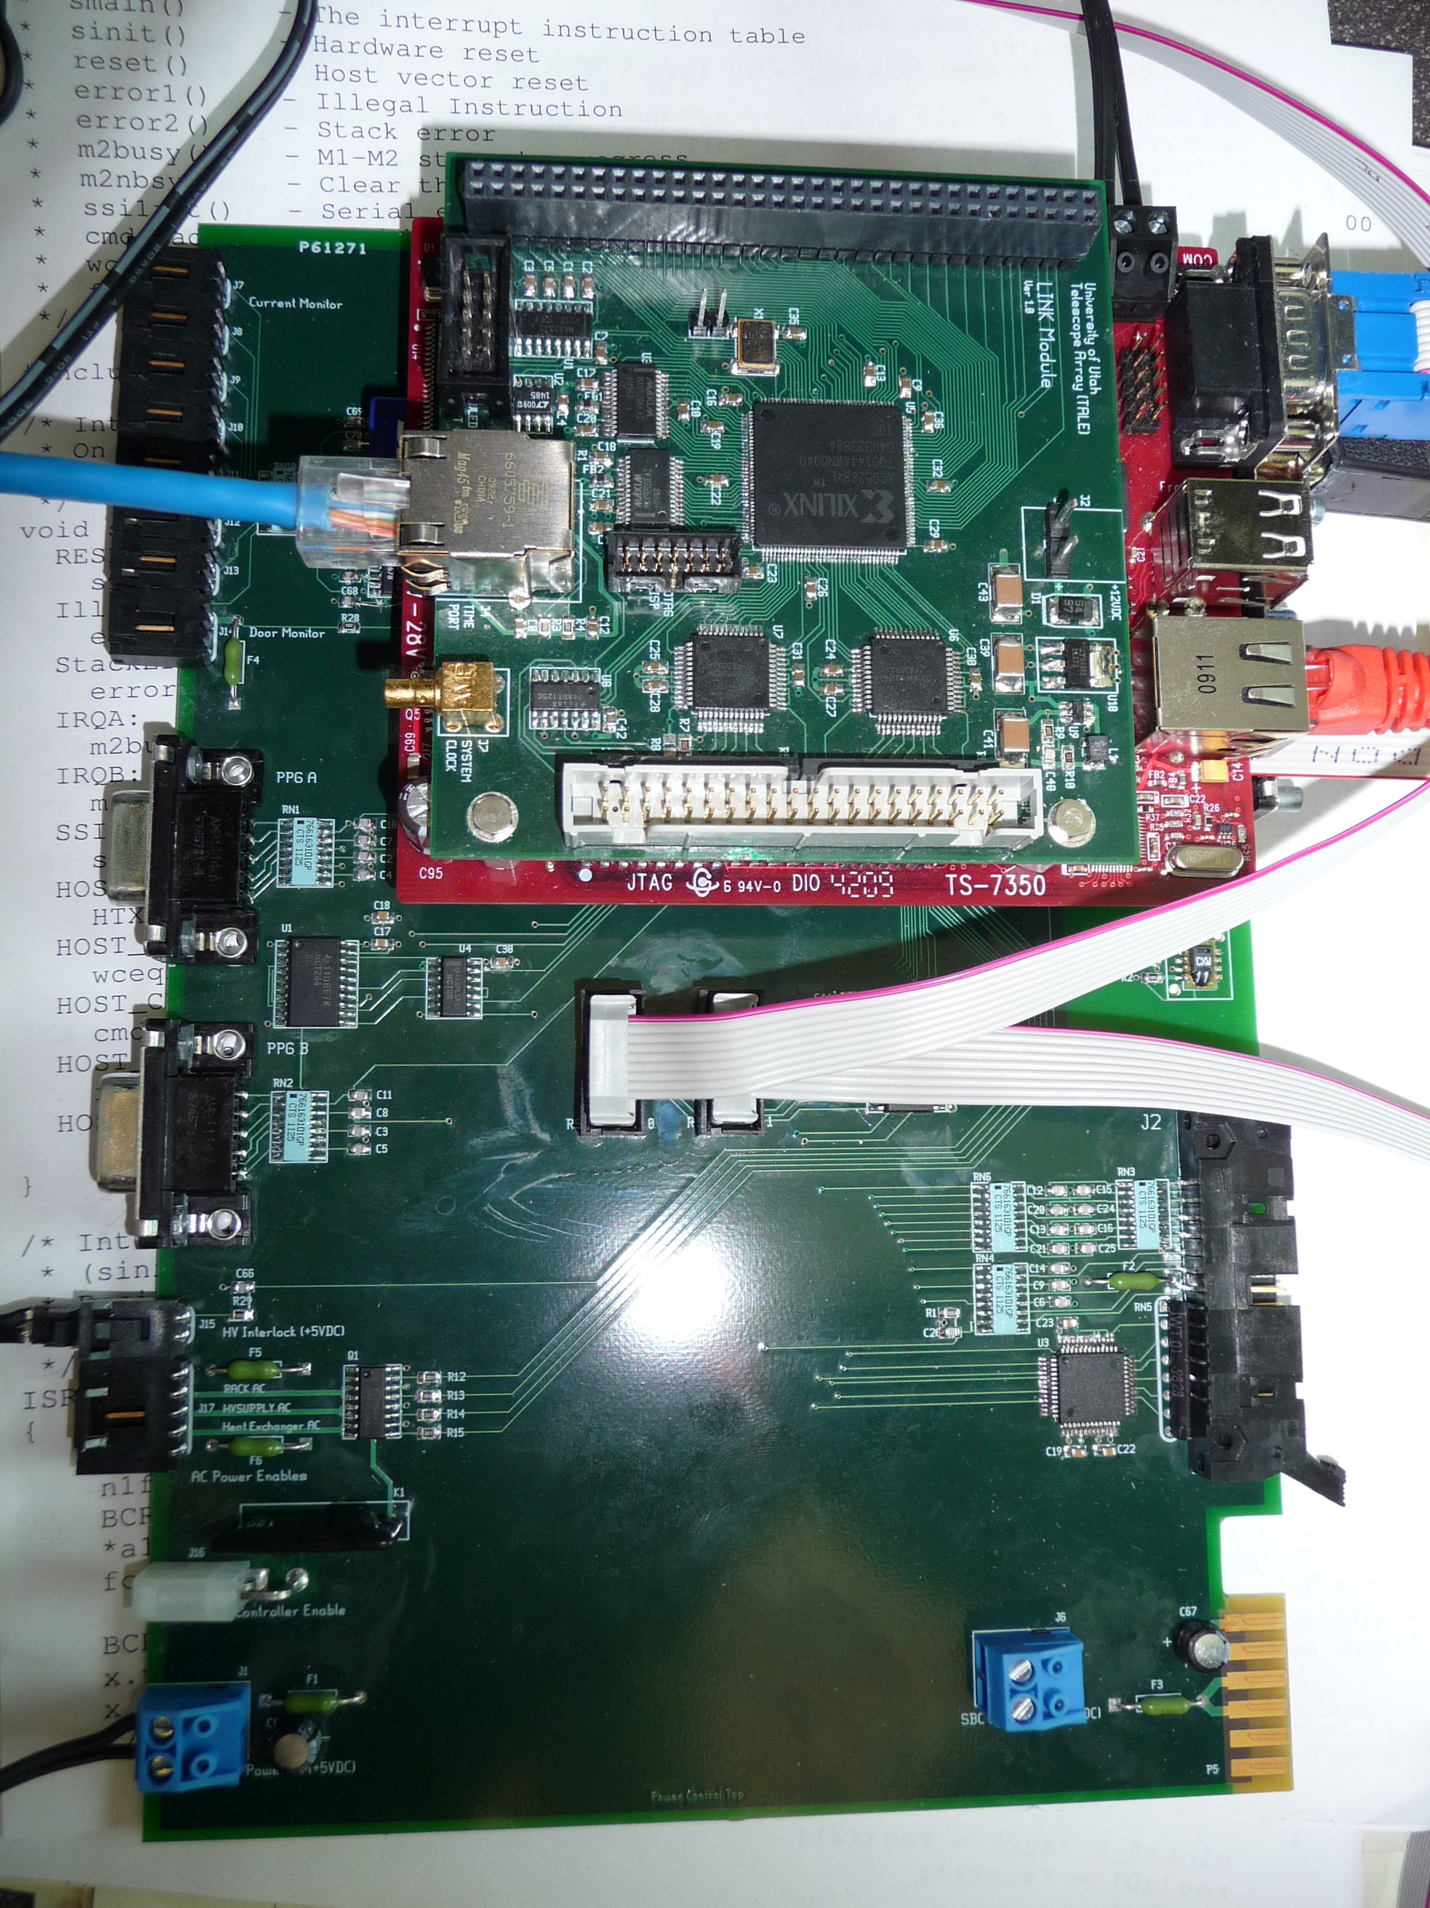
New Power Controller Board
Crate Power
Control Board
Hardware and software HV interlock
LV and HV monitoring
AC Current Monitoring in Rack
Readout for door monitoring
HV
HV
FADC x16
FADC x16
220 V Switched Supply

Slide 27
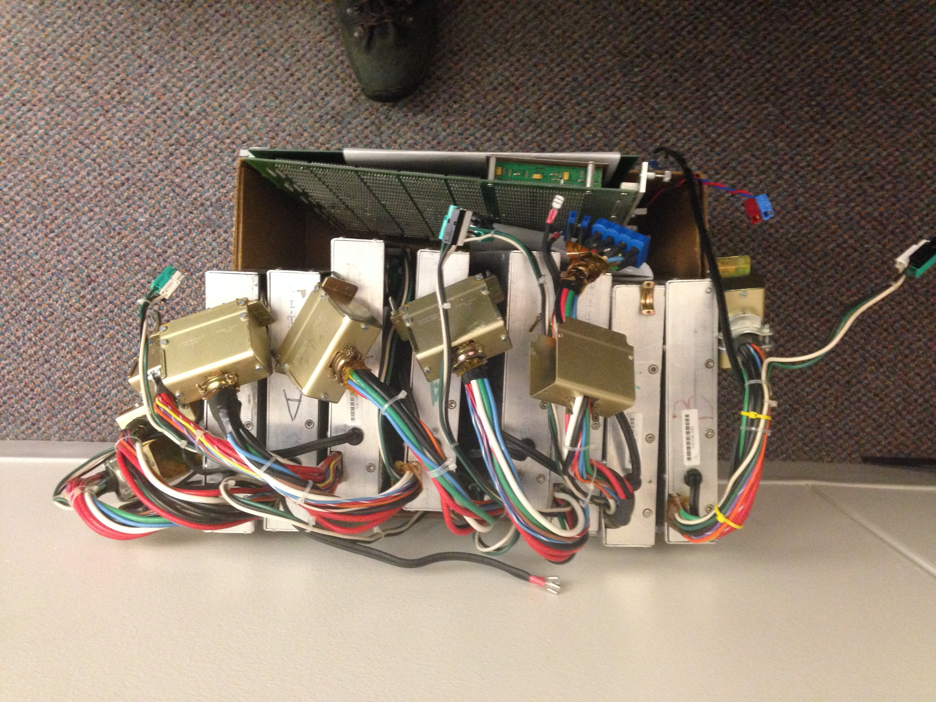
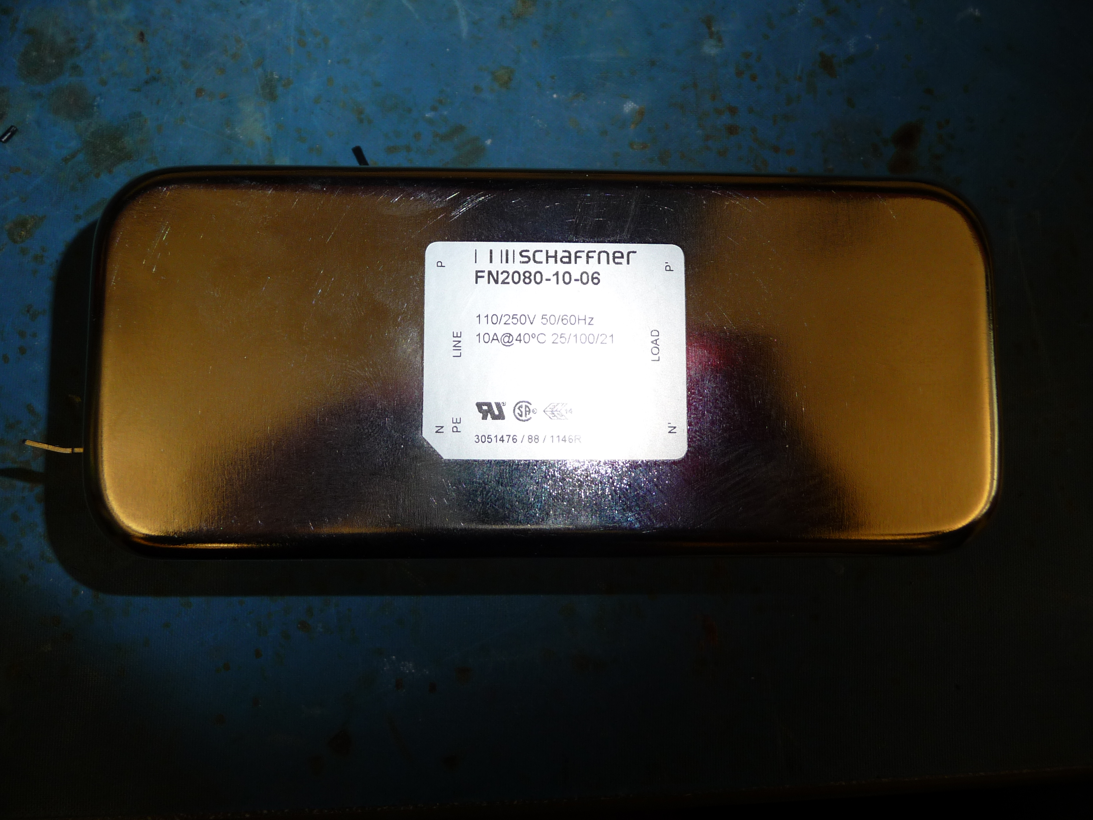
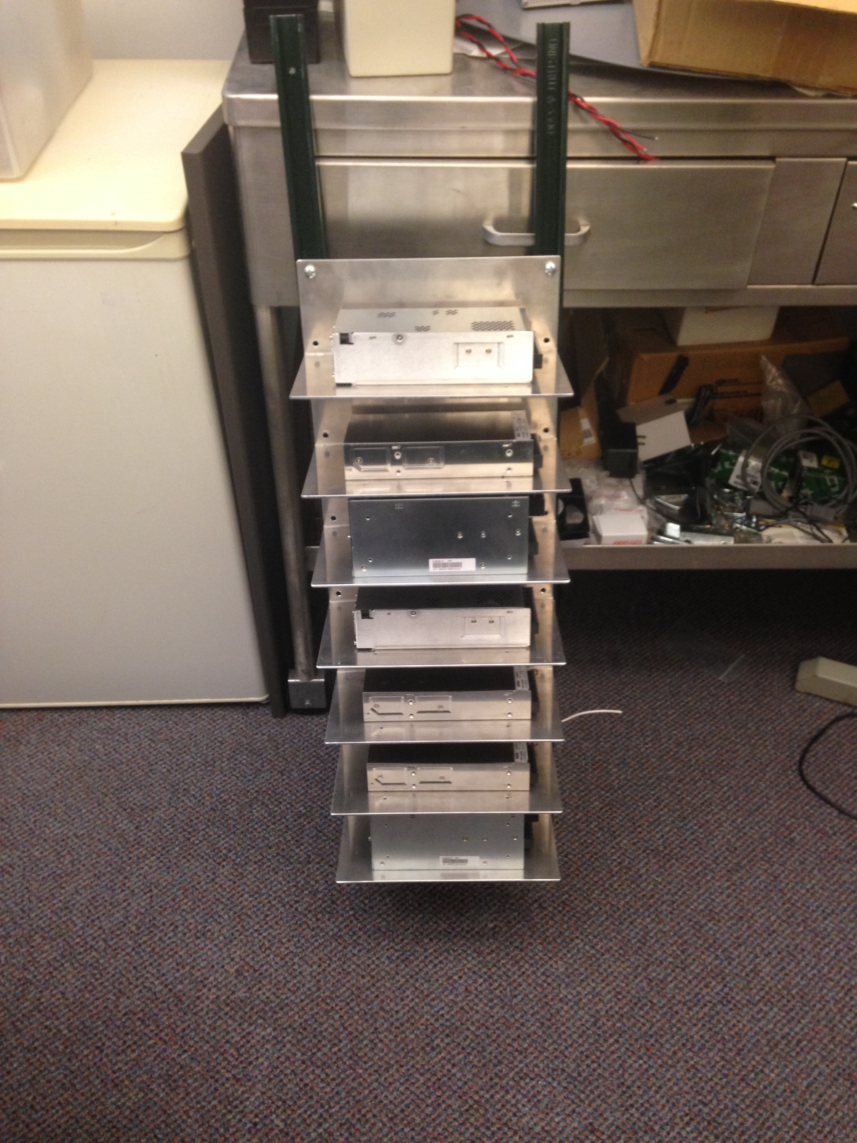
LV Power Supply System
Box Of Failed Supplies
Power Filter
Crate
Chronic failure of old LV supplies lead to
Installation of in-line power filtering
The eventual replacement of the supplies
New Power Supply Modules

Slide 28
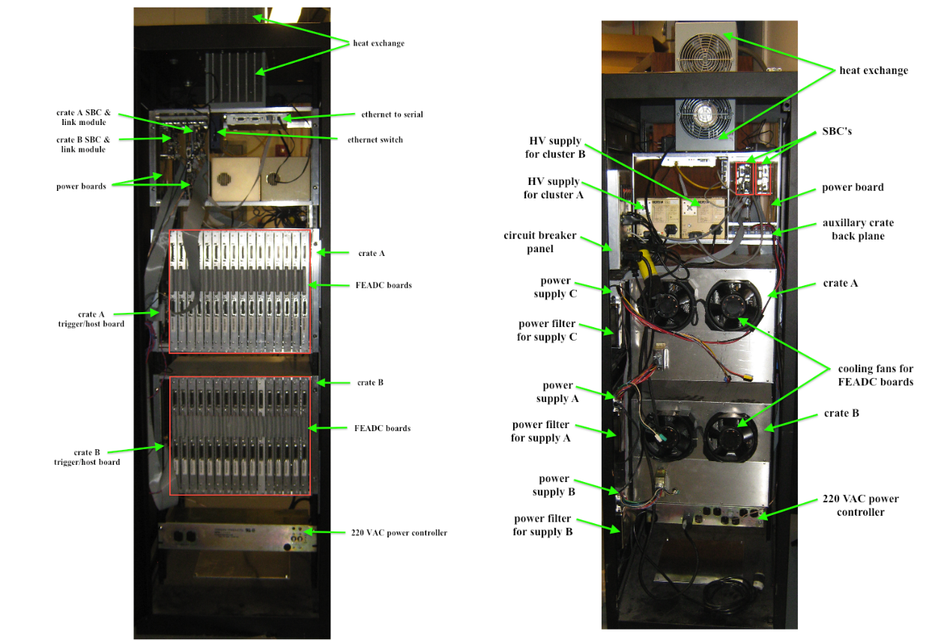
TALE Electronics Crate x5 (2 Telescope Electronics per Crate)

Slide 29
Install Mirrors, Clusters, and Electronics in the Field (Many Accountancy Details for Detector Operation )
Mirror stands must be modified for higher elevations
Cluster Mounts must be modified to add height
New Camera LV supply cables constructed and installed
Cable Trays must be installed
Power and network cables must be run to the racks locations
Central Clock Distribution Cables

Slide 30
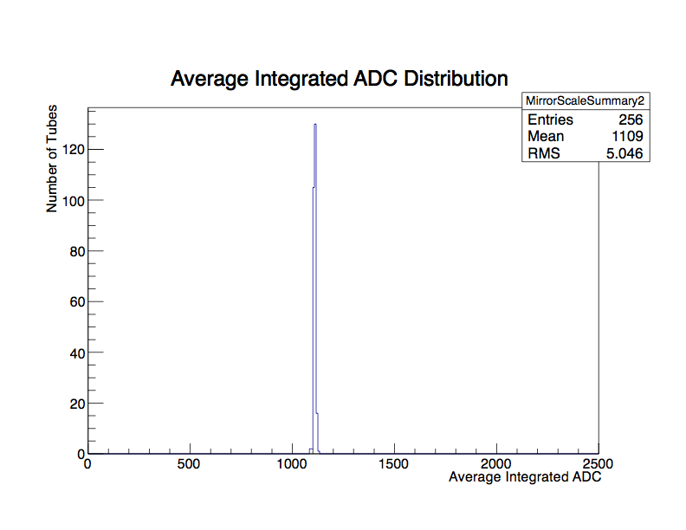
Balanced Cluster: Variable Gain Amplifiers (DACs) Adjusted For Uniform Response
Single UVLED Flash Integrated ADC
We can quickly determine the appropriate DAC values for each channel to achieve uniform response
First Rough Rough Correction yields ~95% uniformity
Iteratively adjusted to obtain best uniformity

Slide 31
Photometric Calibration: Determines Energy Scale and Effective Aperture of Detector Performed Every Run Period
All knowable accounted for:
Filter transmission
PMT Characteristics
etc…
PMT Camera Cluster
UV Filter
Spherical Mirror
Neutral Density Filter
Focus on calibration
revealed low Gain of Epoch 1
RXF-Roving Xenon Flasher:
Calibrated to NIST photodiode

Slide 32
One Entry For Each Tube:
Three Dead Channels For the Entire Detector
TALE RXF Flux Estimate
NIST photo-diode calibration of RXF expectation
Field Calibration Agrees With Primary Calibration
Temperature During Data Collection: m0 TEMP 278.84 (5.69C)
Expected RXF Flux of 11.27 photons/mm^2
From Hybrid Photo Diode Calibration
Measured RXF Flux of 11.25 photon/mm^2
Estimated Temperature 6.1C

Slide 33
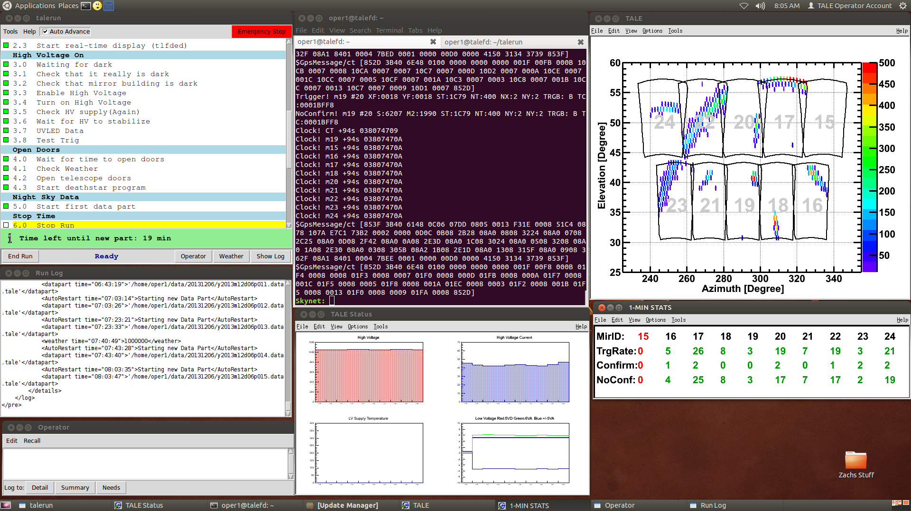
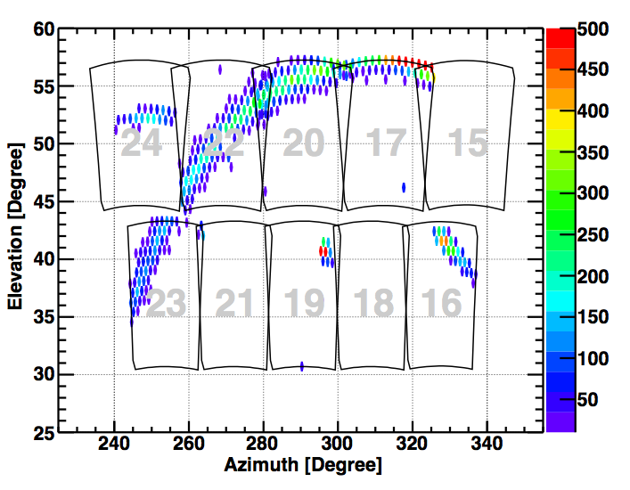
Tale Operation Control Program
TALERUN
Same user interface as Middle Drum
Completely NEW control programs
Began Nightly Operation July 2013
Allows for semi-autonomous operation of the detector

Slide 34
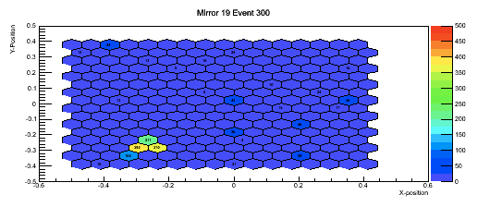
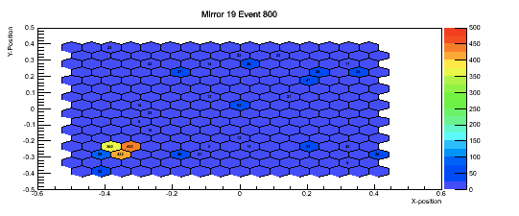
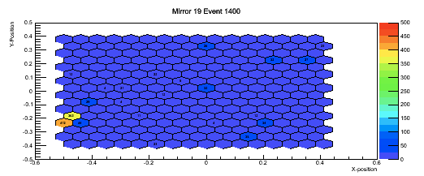
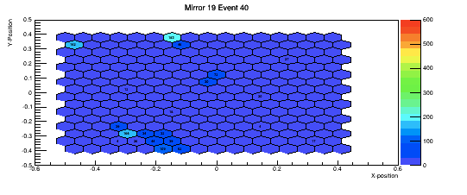
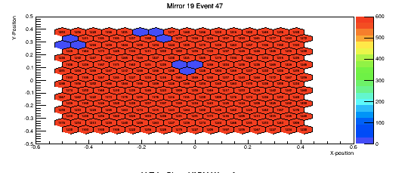
Challenge: Bright Stars
Transit of Sirius
Fills up trigger buffer
Particularly Problematic for RING 4 mirrors
Solution: Disable Tubes Looking at Bright Stars
Track bright objects with STARS program
Disable and revive tubes as stars pass in front of them
Signal gain for Tubes within 1 degree of the star are set to zero.
Example with UV Bright Stars in FOV: No Tube Disabling Software
UVLED FLASH with tube disabling software Activated

Slide 35
TALE Spectrum Measurement
Use TALE detector to determine if there is a break in the cosmic ray spectrum in the region of 10^{16.5}-10^{18.5} eV.
“Close the Loop” discover any problems / issues
Calculating the Energy Spectrum using TALE Mono events (ring 3 and ring 4 only) is an end to end check of:
Detector Operation
The Analysis Toolchain
Energy Scale
Data Set (EPOCH 1)
Sept 2013-Jan 2014
246 hours Data subset used (Good Weather Only)
Minimal Quality Cuts. Events with dominant Scintillation, Cherenkov, mixed light contributions all used.

Slide 36
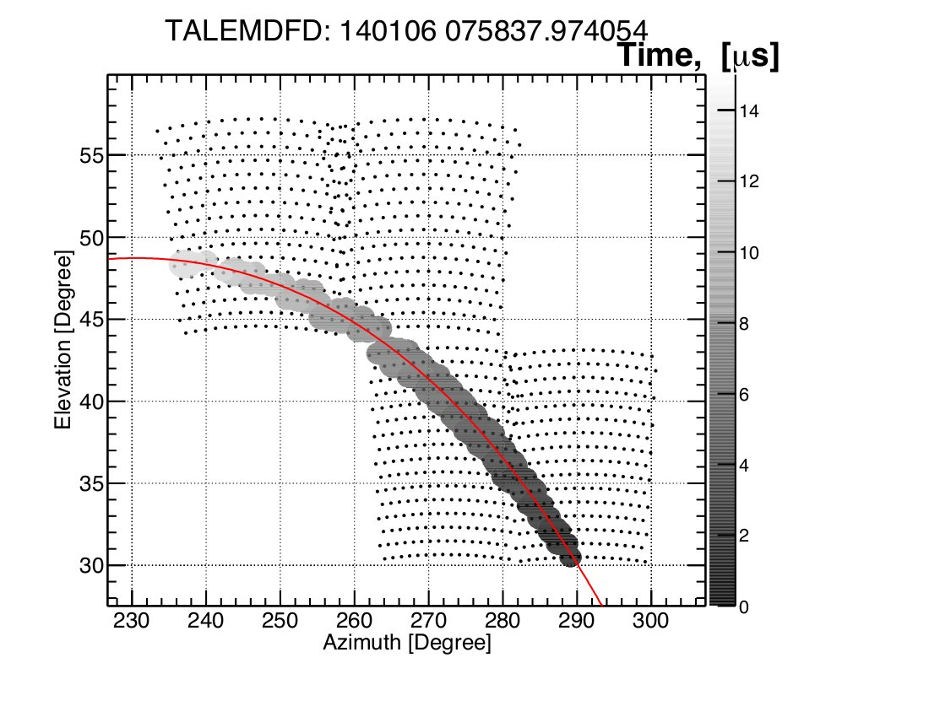
Processes in Event Reconstruction
Standard Shower reconstruction routines used to reconstruct the geometry and energy of TALE events
Shower-Detector Plane fit
Rayleigh filter
Laser Filter
Geometry Fit
Profile Constrain Geometry Fit

Slide 37
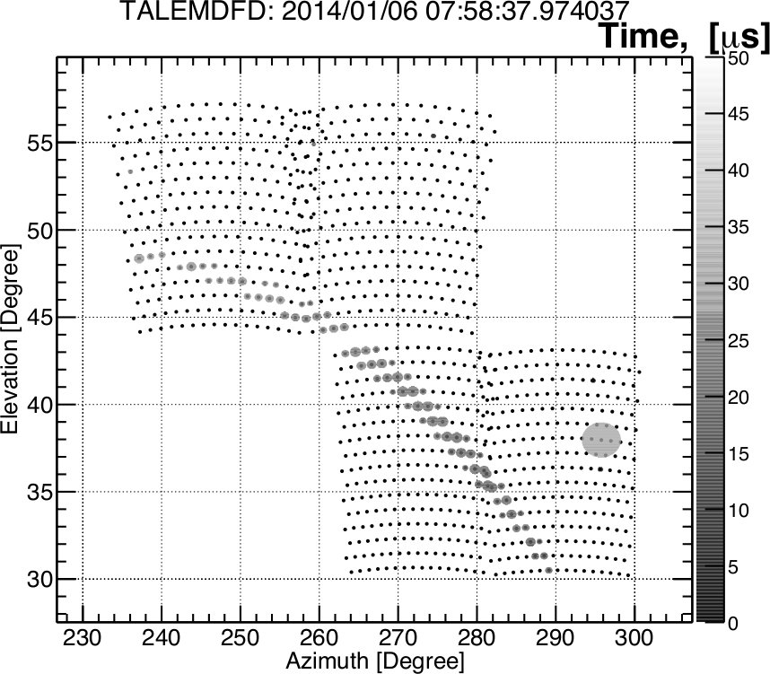
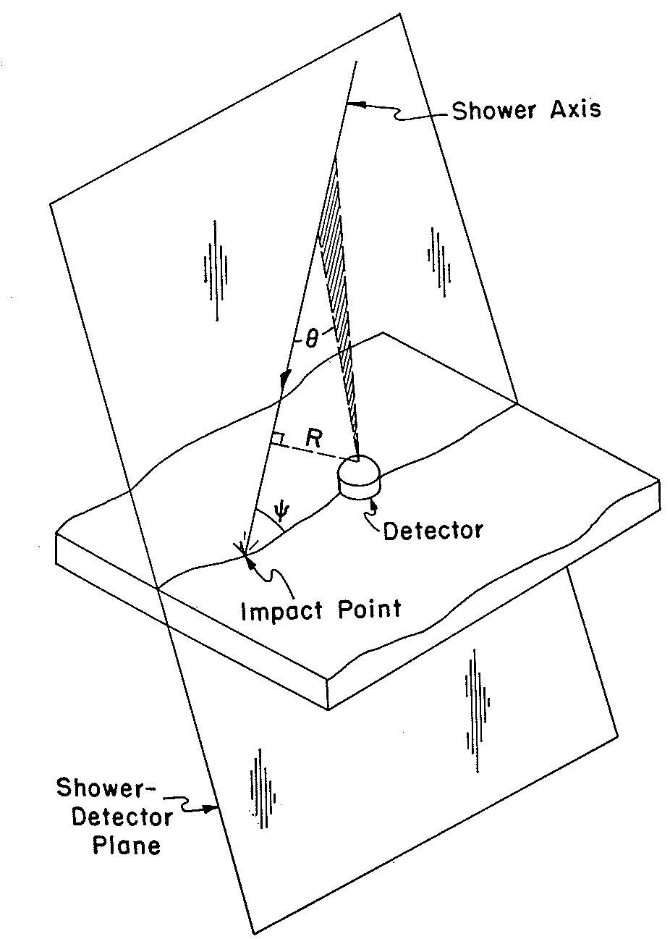
Shower Detector Plane
The plane fitting process is an iterative process to determine the shower plane and to remove noise tubes
Raw Data With Noise Tubes
Noise Tubes
Noise Tubes Removed and Plane Fit
Shower Axis
Tubes are marked as “bad” if they are removed from the track in either space or time.
Tubes further than 6^{O} from the track are removed.
Detector
Plane Intersecting Shower
And FD

Slide 38
Shower Detector Plane
The plane fitting process is an iterative process to determine the shower plane and to remove noise tubes
Raw Data With Noise Tubes
Noise Tubes Removed and Plane Fit
Tubes are marked as “bad” if they are removed from the track in either space or time.
Tubes further than 6^{O} from the track are removed.
Polynomial Fit

Slide 39
Rayleigh Filter
Removes Noise Events by testing the probability that the event could have been randomly generated.
Rayleigh vector formed by drawing vector for each tube to all adjacent tubes with a later time and then summing all vectors

Slide 40
Geometry Fit
After the SD-plane is determined the track can be uniquely determined by fitting for the angle in the SD-plane and the distance of closest approach of the shower.
Used as a Starting Place for the Profile Constrained Geometry Fit
Light From higher points in the shower
arrive at the detector first
The noise tubes have already been removed during the plane fit

Slide 41
Profile Constrained Geometry Fit
Fix the value of Xmax to a series of values
In my case the chosen values were 500, 550, 600, 650,700,750 g/cm²
Fit the profile to a Gaisser-Hillas Using inverse Monte Carlo.
Vary angle in S-D plane improves profile fit
For the best value of Xmax and Angle do a profile fit in that vicinity
Increases the Energy Resolution (short tracks)
Fits the direct and scattered
Light contributions

Slide 42
Scintillation Light
Emission Spectra
Electron Energy Deposition

Slide 43
Cherenkov Light
Events with high Cherenkov fraction used to be discarded by previous experiments
Have learned how to analyze using PCGF

Slide 44
Mixed Event

Slide 45
Measuring the Cosmic Ray Flux
Number of Observed Events
Flux
Effective Aperture of the Detector:
Calculated using Monte Carlo
Detector On-Time
(246 Hours)
Width of
the Energy Bin

Slide 46
Geometrical Aperture
Geometrical Aperture is the convolution product
SOLID ANGLE and AREA
Solid Angle
Area
RP_{MAX}
RP_{MIN}

Slide 47
Reconstructed Event Aperture
Number of Events
that trigger and reconstruct
Number of Events thrown into
geometrical aperture
TALE Not Equally sensitive at all energies and for all shower
geometries. Monte Carlo used to calculate the effective aperture
35% Difference

Slide 48
Composition Assumption
HiRes-Mia
Measured Composition
H4A (Gaisser. Astropart. Phys. 35 (2012)801-806)
Predicted Composition
HiRes / TA
Composition
H4A models composition contributions
The the energy energy spectrum

Slide 49
Quality Cuts
Improve Energy Resolution
Reduce composition dependence
Proton MC
Iron MC
~12% Energy Resolution

Slide 50
Effective Aperture After All Cuts
Composition dependence
reduced to <5% level

Slide 51
DATA – MC VALIDATION RP – Distance of Closest Approach
KS Test > 0.5
Indicates distributions
agreement
0.16
Blue Point - Data
Red Line – MC Expectation
Sample Comparison: See Dissertation Appendix I for 0.1 log(E) comparisons

Slide 52
DATA-MC Validation PSI – Angle in the Shower Detector Plane
0.84
Sample Comparison: See Dissertation Appendix I for 0.1 log(E) comparisons

Slide 53
DATA – MC VALIDATION THETA – Zenith Angle
0.98
Shower
Track
Θ
Sample Comparison: See Dissertation Appendix I for 0.1 log(E) comparisons

Slide 54
DATA – MC VALIDATION PHI – AZIMUTH ANGLE
N
0.95
Φ
W
E
Detector
Shower Detector
Plane
S
Sample Comparison: See Dissertation Appendix I for 0.1 log(E) comparisons
Shower Core

Slide 55
TALE MEASURED SPECTRUM
246 Hours

Slide 56
TALE Epoch 1 Spectrum Measurement
Epoch 1 : Detector Evaluation Data Set
Determine if there is evidence for a break in the power law

Slide 57
Single vs. Broken Power Law
Difference in Chi² Between two nested models can be treated as a Chi²

Slide 58
Difference in Expected Number of Events
1 sigma deviation
from fit
Fit to data above 10^{17.3}eV
Check significance based on the deficit in the number of events
Number of expected
events from best fit
Number of Data
Events Observed
Number of events expected from std deviation in fit uncertainty

Slide 59
Future Studies
Systematic Uncertainties
Model Dependency of Aperture
QGSJet II-4, EPOS
Fluorescence Yield Uncertainty ~10%
Analysis of Epoch 3 Data Set (10x Epoch 1)
Need to ensure the break is not an
artifact of the uncertainty in the
fluorescence yield

Slide 60
Future Studies
Integration with
MDFD. Overlap and connect to higher energy measurements
TALE SD. Restrict shower geometry for composition measurements
TALE
MD

Slide 61
Conclusions
TALE detector successfully instrumented and deployed to the field.
TALE Cross Calibrated with MDFD
TALE SD currently being instrumented
TALE Lowers the Energy Threshold of Telescope Array to at least 10^{16.5} eV
EVIDENCE For a Break in the Cosmic Ray Spectrum at 10^{17.25 +/- 0.05} eV
Motivates further exploration of cosmic ray spectrum and composition in this energy range.
This may indicate a transition in the types of sources generating cosmic rays.

Slide 64
Beginning of Grad School
Last Fall

Slide 65
Backup Slides

Slide 66
Difference in Expected Number of Events
Fit to data below 10^{17.3}eV
1 sigma deviation
from fit

Slide 67
Hires-II Comparison

Slide 68
Profile Constrained Geometry Fit (cont…)
Timing Geometry Only
Profile Constrained

Slide 69
Missing Energy Correction
QGSJET II-3 Missing Energy
Heavier Elements have:
Larger Cross Sections
Higher secondary particle multiplicity

Slide 70
Energy Resolutions
ALL ENERGIES
CKOV FRAC < 0.2
~10% Energy Resolution

Slide 71
Distance of Closest Approach Resolution
Zenith Angle Resolution

Slide 72
Azimuth Angle Resolution
Angle in Shower Detector Plane Resolution

Slide 73
XH CUT- Depth of First Observation of the Track
Up to 35% difference in Aperture
Based on primary type
without XH Cut
XH CUT minimizes
uncertainty
in flux due to
composition
uncertainty

Slide 74
Reconstruction Bias Correction

Slide 76
Night Sky Background

Slide 77
Thrown MC Histograms

Slide 78
PMT Calibration

Slide 79
RXF Emission

Slide 80
Introduced Dead Time

Slide 81
FADC OVERVIEW

Slide 84
FADC Memory Space

Slide 85
Quartz vs Teflon Diffusers

Slide 87
Extragalactic Cosmic Rays
10²⁰ eV
Threshold
10¹⁶ eV
Threshold
“Hillas Plot”: Estimate of Maximum Particle Energy
Notes:
"Nucleus drawing" by Marekich - Own work (vector version of PNG image). Licensed under CC BY-SA 3.0 via Wikimedia Commons - http://commons.wikimedia.org/wiki/File:Nucleus_drawing.svg#mediaviewer/File:Nucleus_drawing.svg
Credit: X-ray: NASA/CXC/CfA/R.Kraft et al; Radio: NSF/VLA/Univ.Hertfordshire/M.Hardcastle; Optical: ESO/VLT/ISAAC/M.Rejkuba et al.
http://apod.nasa.gov/apod/ap140712.html

Slide 88
SCINTILLATION PSI RESOLUTION

Slide 89
Energy Resolutions
~12% Energy Resolution

