Slide 1
The Analysis of Downward Terrestrial Gamma-ray Flashes Using a Large-area Cosmic Ray Detector
Jackson Remington
Ph.D. Thesis Defense
Telescope Array Project
Department of Physics and Astronomy, University of Utah

Slide 2
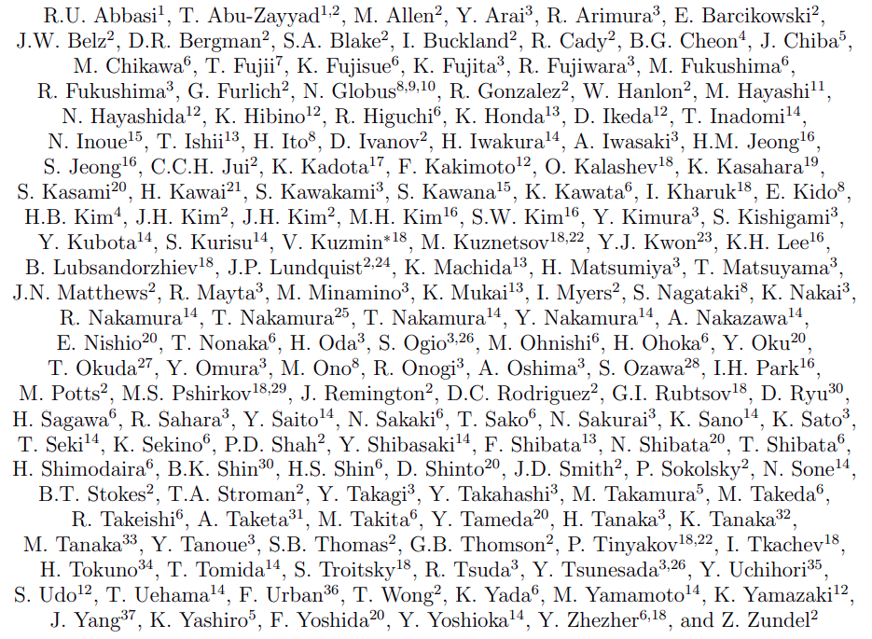
Telescope Array Project
Jackson Remington - Thesis Defense - 2021/09/24

Slide 3
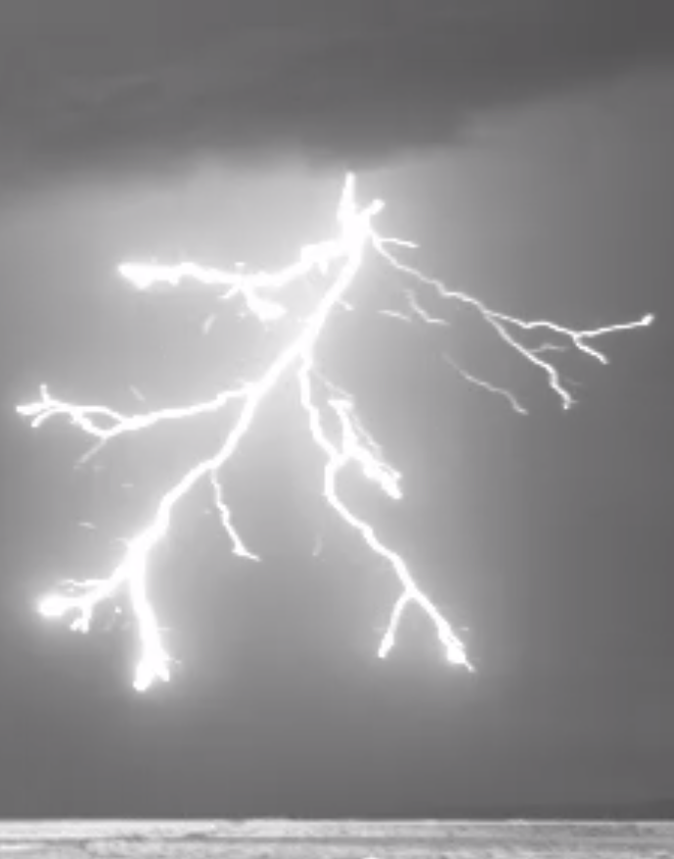
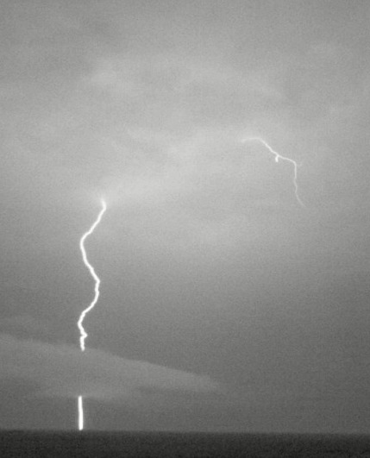
TA / LMA Collaboration
R. Abbasi¹, J. Belz², R. LeVon², P. Krehbiel³,
J. Remington², W. Rison³, D. Rodeheffer³,
M. Stanley³, K. Smout²
¹ Department of Physics, Loyola University
² Department of Physics, University of Utah
³ Langmuir Laboratory, New Mexico Institute of Mining and Technology
The work reported here was partially supported by National Science
Foundation grants AGS-1205727, AGS-1613260, AGS-1720600, and AGS-1844306.
We greatly acknowledge the contributions of our colleagues at the Telescope Array
Cosmic Ray Observatory. We also thank VAISALA for providing NLDN
data under their academic research use policy.
Jackson Remington - Thesis Defense - 2021/09/24

Slide 4
Outline
Background of Terrestrial Gamma-ray Flashes (TGFs)
History of TGFs
Thundercloud and lightning anatomy
TGF production and development
Instrumentation
Telescope Array Surface Detectors
Lightning detectors
TGF Observations at Telescope Array
Previous observations 2008-2016
2018 TGFs: observations
2018 TGFs: analysis
2018 TGFs: interpretation
Conclusion
Jackson Remington - Thesis Defense - 2021/09/24

Slide 5
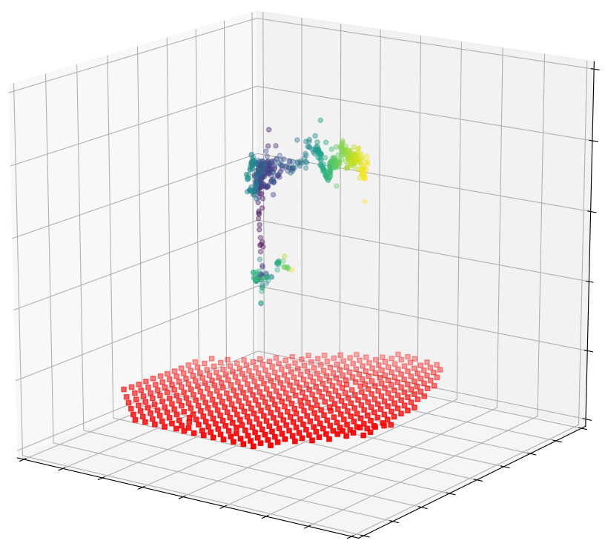
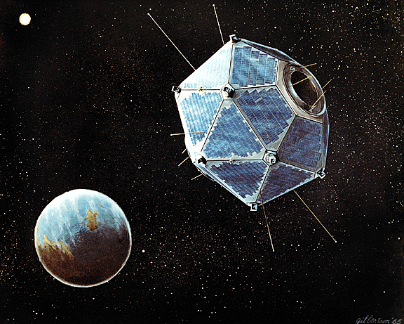
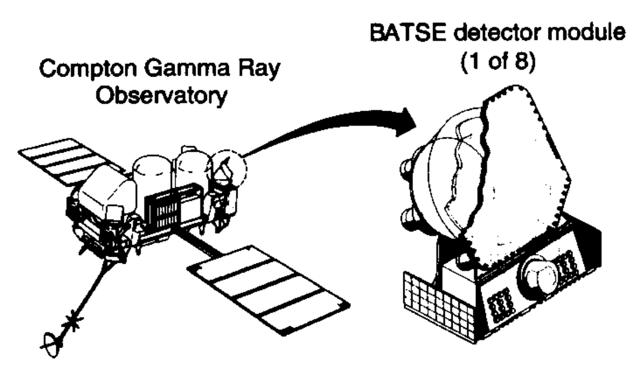
TGF History: A Series of Happy Accidents
NASA
Fishman, et al. (1994), Science (264), 1313
Jackson Remington - Thesis Defense - 2021/09/24

Slide 6
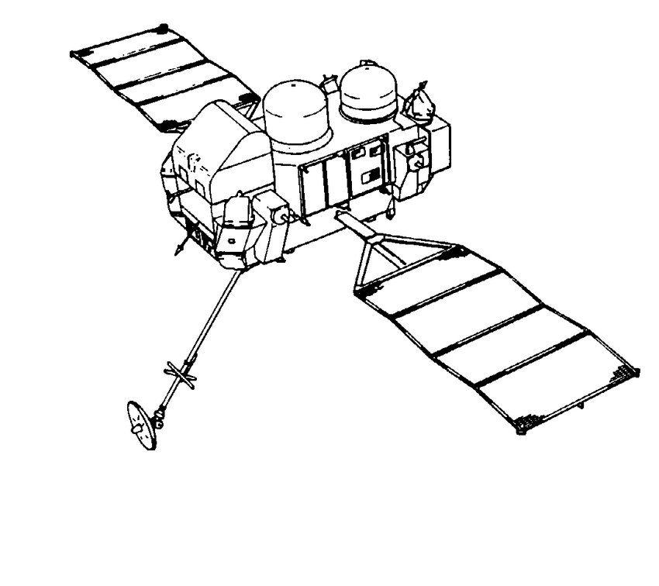
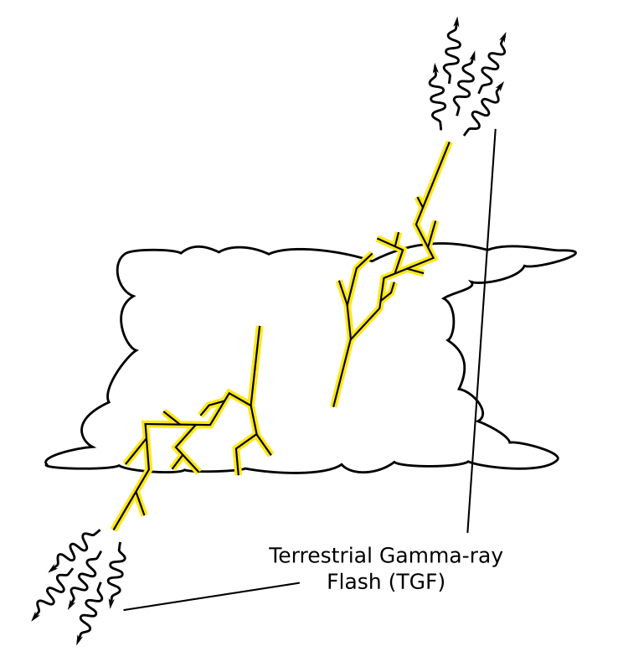
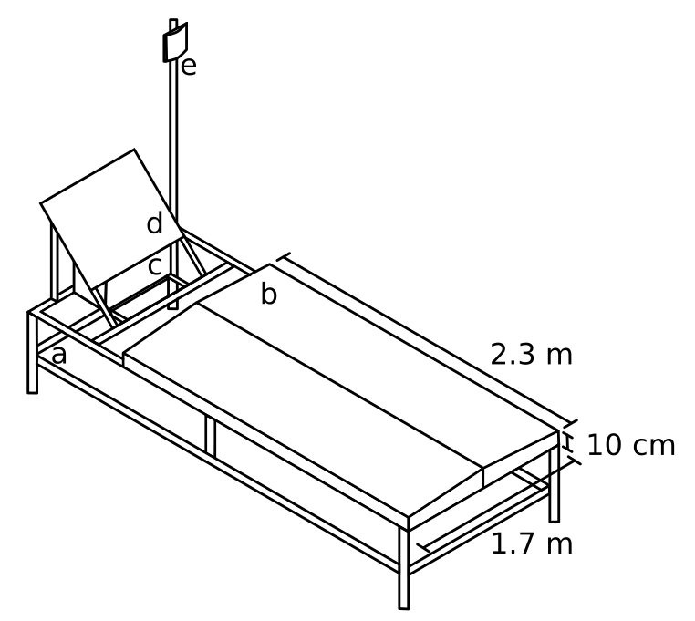
Terrestrial Gamma-ray Flashes (TGFs)
TGFs are electromagnetic showers produced during lightning flashes
Satellite observations of TGFs:
Contain 10¹⁵-10¹⁹ photons
Have characteristic gamma-ray energy of 7 MeV
Occur in the initial stages of lightning
Durations of 10s-100s of 𝜇s
Jackson Remington - Thesis Defense - 2021/09/24

Slide 7
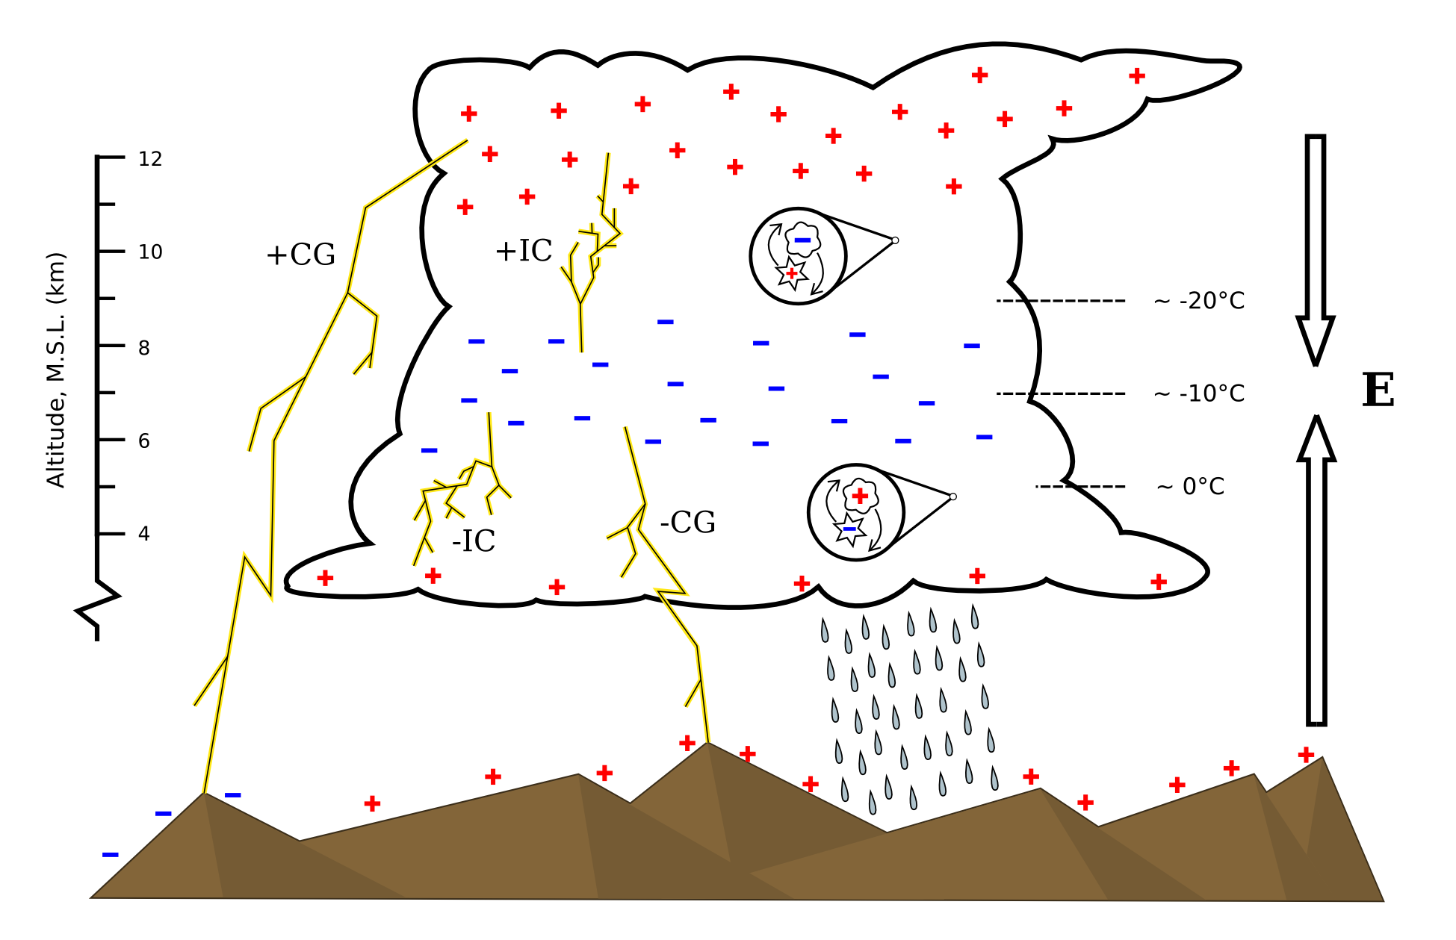
Thundercloud
Anatomy
Jackson Remington - Thesis Defense - 2021/09/24

Slide 8
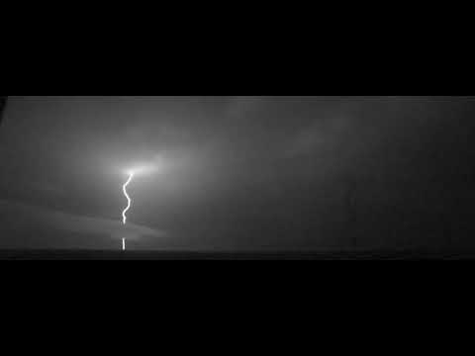
Stages of Lightning
Leader stage creates a conducting pathway
Average leader speed 10⁵-10⁶ m/s
8 ms leader time
Once a pathway is formed, the storm “shorts out”
Bright return stroke(s) discharge the electric field
Can occur multiple times in a single flash (15 ms separation)
40,000 FPS camera:
1 ms of lightning = 1.3 s of video
Jackson Remington - Thesis Defense - 2021/09/24

Slide 9
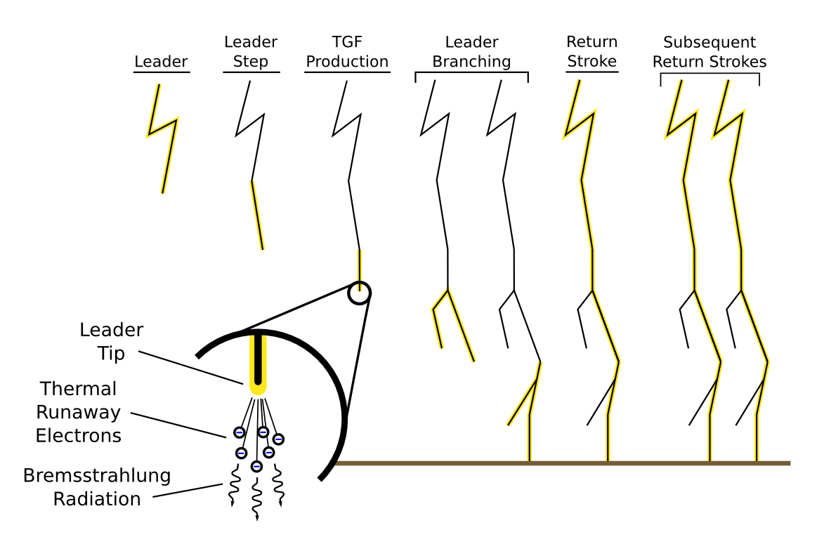
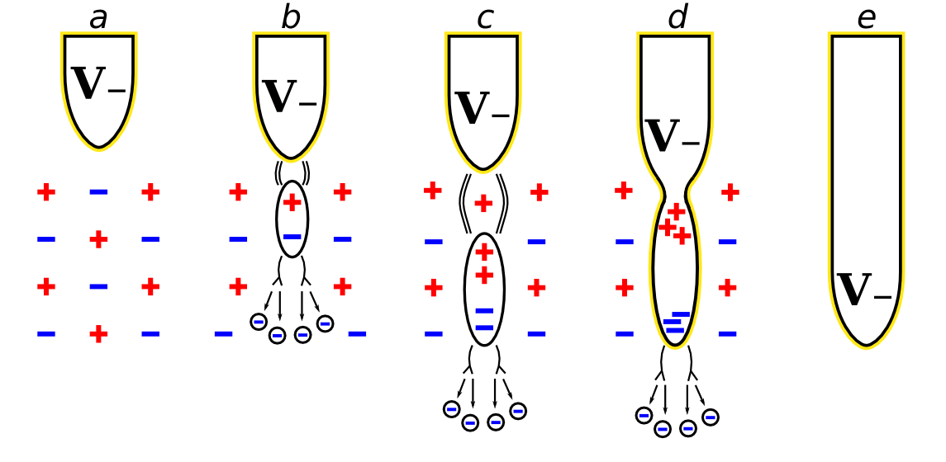
Stages of Lightning
Leaders are hot, conducting channels of air allowing current to flow
Leaders advance discretely in ~50 m steps at 10⁵-10⁶ m/s
TGF production is associated with the leader stage
Streamers are non-conducting systems of ionized air
The bright return stroke(s) occur once the leader “shorts out” charge regions
Leader stepping process (left)
(a): Electrons concentrate in the leader tip and generate strong fields
(b): Charges separate ahead of the leader and generate streamer systems
(c): The air heats up and becomes fully conducting as a disconnected ‘space stem’
(d): The stem reconnects with the existing leader
(e): Potential transfers to the new leader step and the process repeats
Jackson Remington - Thesis Defense - 2021/09/24

Slide 10
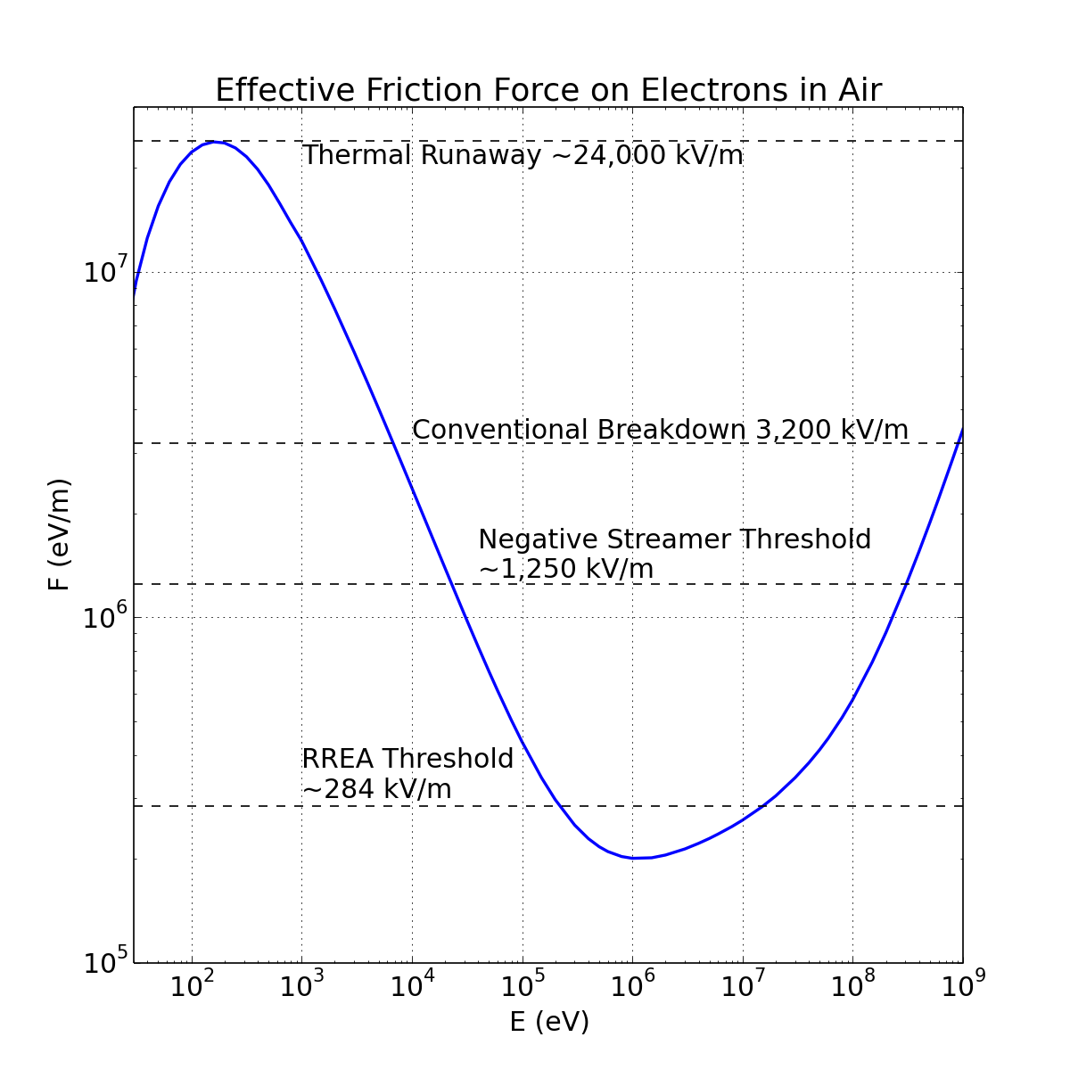
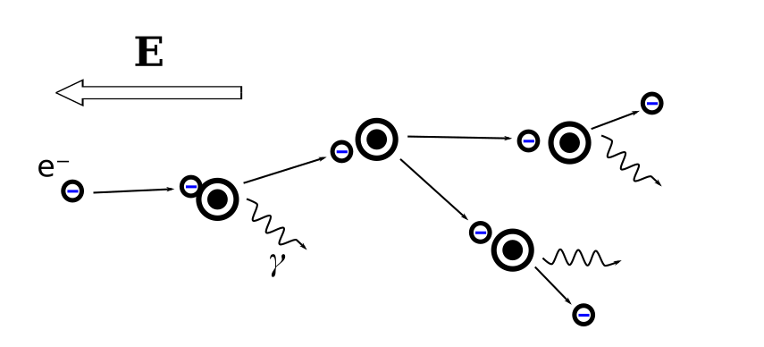
TGF Production and Development
Electrons gain energy from the thunderstorm’s ambient electric field
Lose energy due to atmospheric interactions - primarily bremsstrahlung radiation and ionization
Electrons above the curve gain more energy from the applied electric field than they lose due to atmospheric interactions
Jackson Remington - Thesis Defense - 2021/09/24

Slide 11
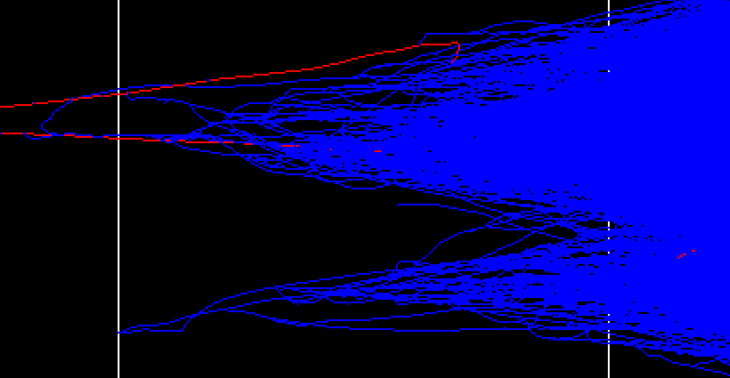
TGF Production and Development
Electrons above the curve gain more energy from the applied electric field than they lose due to atmospheric interactions
Cascades of particles above the curve multiply quickly, called relativistic runaway electron avalanches (RREA)
Electrons must exist above the curve in abundance in order to seed RREA cascades
Cosmic ray secondaries
Cold runaway mechanisms (supported by this study)
Feedback positron and secondary shower
Backscattered positrons and photons can seeed additional showers in a process called feedback, greatly amplifying the shower fluence and duration
Original seed and RREA
Ryan LeVon
Jackson Remington - Thesis Defense - 2021/09/24

Slide 12
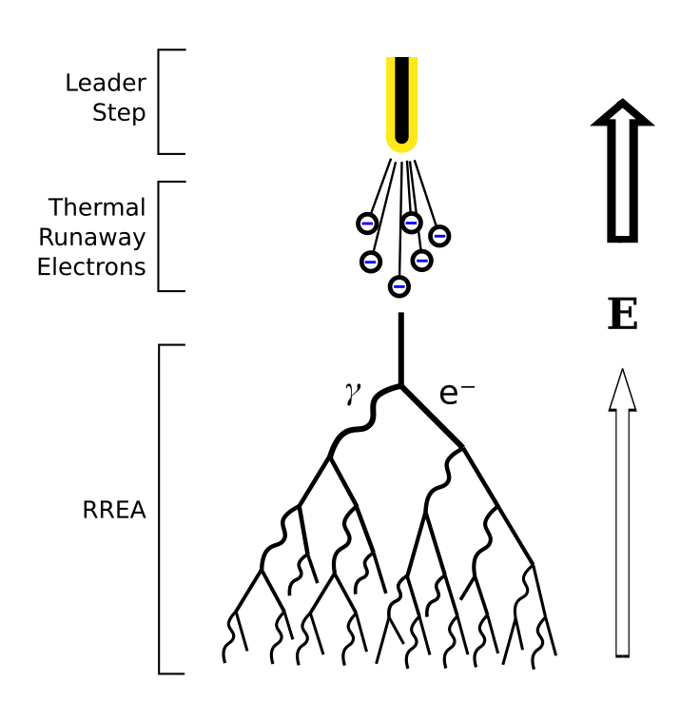
TGF Production and Development
Our observations suggest that RREA is seeded during leader steps
RREA develops in the larger-scale thunderstorm fields (~10⁵ V/m)
E field enhanced near leader tips (~10⁶ V/m)
E field enhanced further by advancing streamer systems (~10⁷ V/m)
Cold electrons are ejected at relativistic speeds (~10⁶ eV)
Jackson Remington - Thesis Defense - 2021/09/24

Slide 13
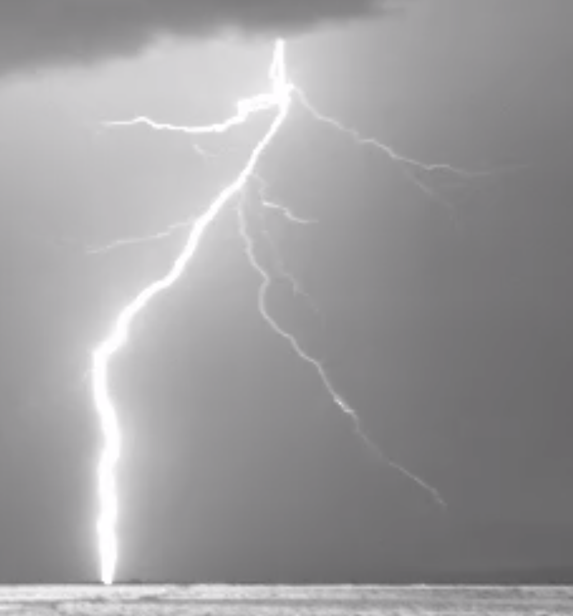
Outline
Background of Terrestrial Gamma-ray Flashes (TGFs)
History of TGFs
Thundercloud and lightning anatomy
TGF production and development
Instrumentation
Telescope Array Surface Detectors
Lightning detectors
TGF Observations at Telescope Array
Previous observations 2008-2016
2018 TGFs: observations
2018 TGFs: analysis
2018 TGFs: interpretation
Conclusion
Jackson Remington - Thesis Defense - 2021/09/24

Slide 14
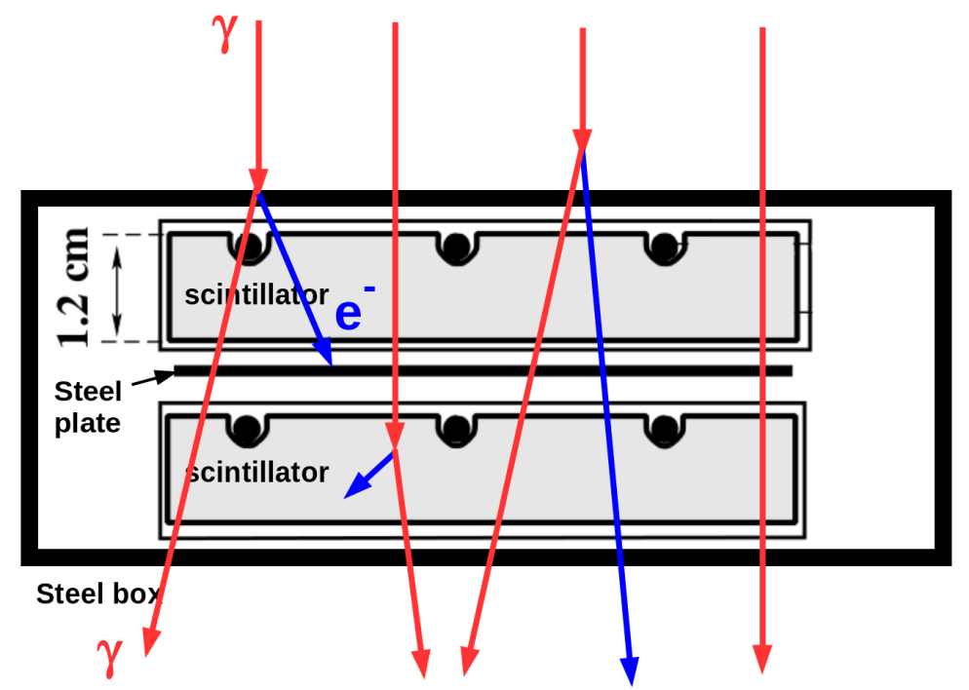
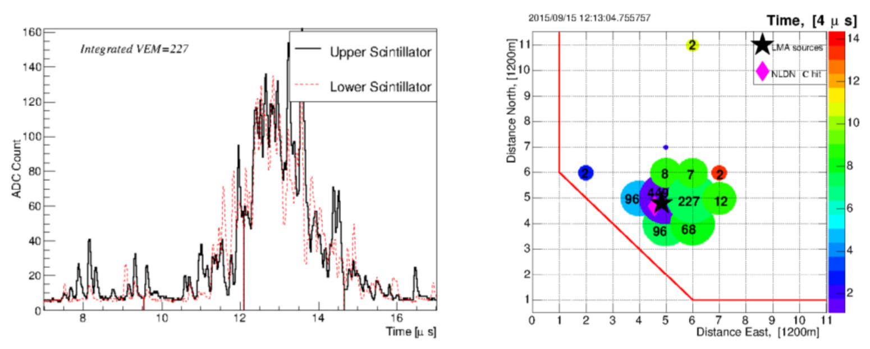
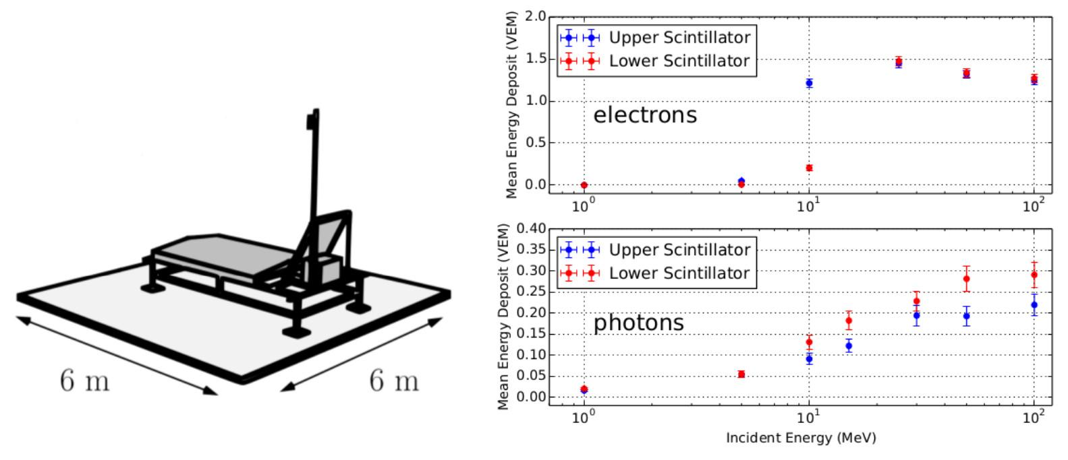
Instrumentation: Telescope Array
507 scintillation detectors (SDs) covering the 700 km² main array
Able to capture the entire ground-level footprint
TASDs contain two layers of plastic scintillator for detecting charged particles
Efficient for charged particle detection
Inefficient for neutral gamma-rays
Energy deposit in the form of fluorescence light is captured for each layer and counted on local electronics.
Dmitri Ivanov
Ryan LeVon
Jackson Remington - Thesis Defense - 2021/09/24

Slide 15
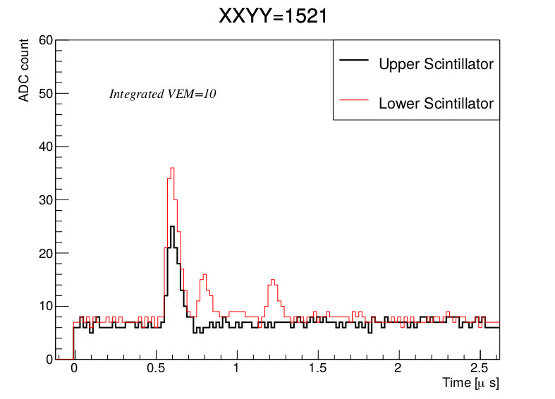
Instrumentation: gamma-ray detection
In some cases, TASD waveforms show individual particle hits
Energy deposit is consistent with 1 vertical equivalent muon (VEM), or ~2 MeV/cm
Minimum energy case:
A Compton-scattered electron deposits all of its energy into one layer of scintillator (2.4 MeV for 1.2 cm)
If produced inside the scintillator itself (no energy loss to exclosure), the minimum-energy photon had 2.4+0.2=2.6 MeV
Penetrating case:
An electron penetrates both scintillators and the steel separating plate (~1.4 MeV loss)
Minimum photon energy = 2.4+1.4+2.4+0.2=6.4 MeV
(Keep in mind these are lower limits - the likelihood of grazing angles means the original photons probably had more energy)
Jackson Remington - Thesis Defense - 2021/09/24

Slide 16
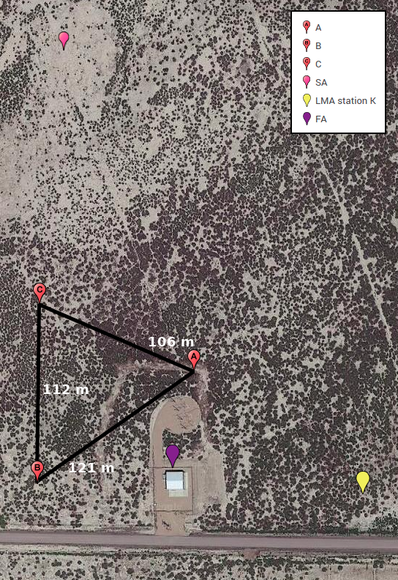
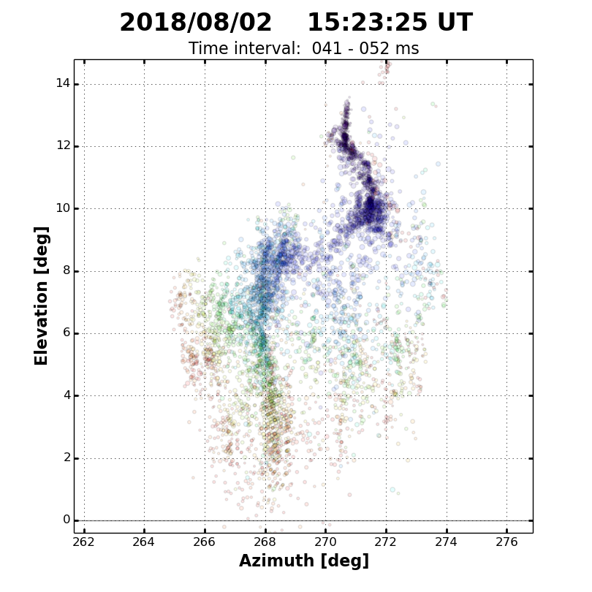
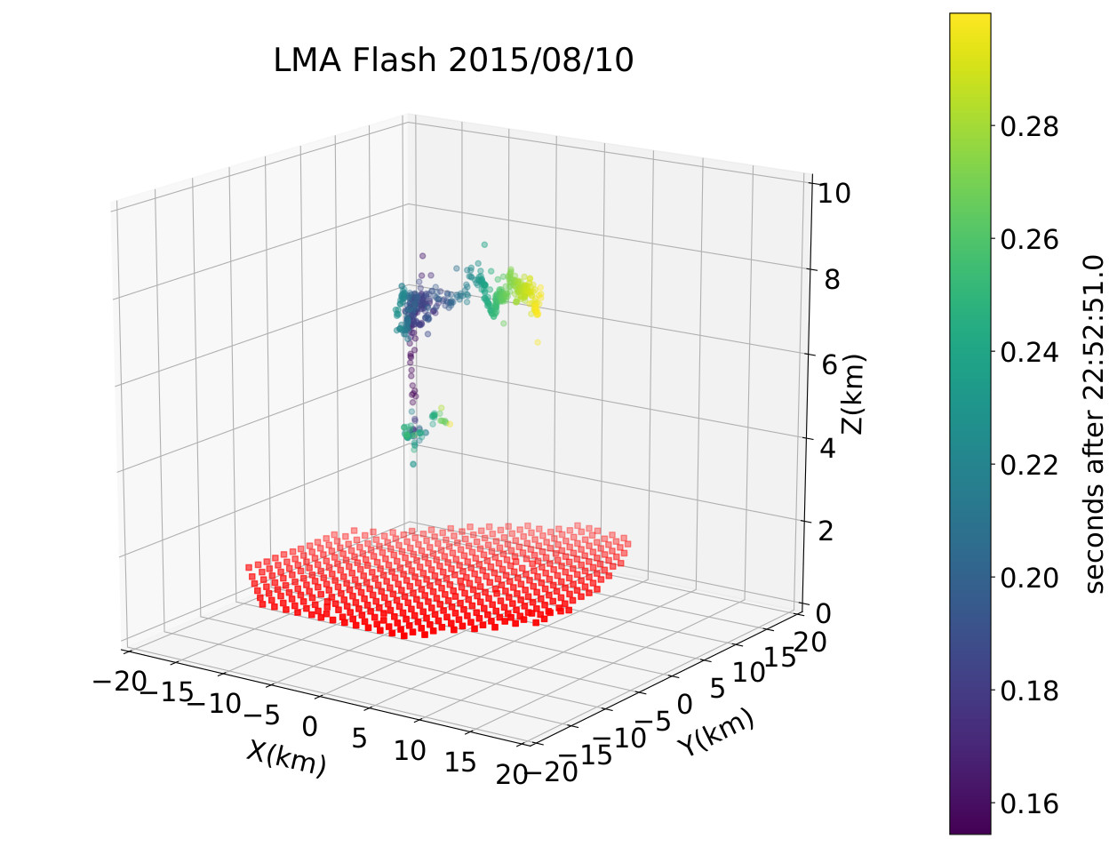
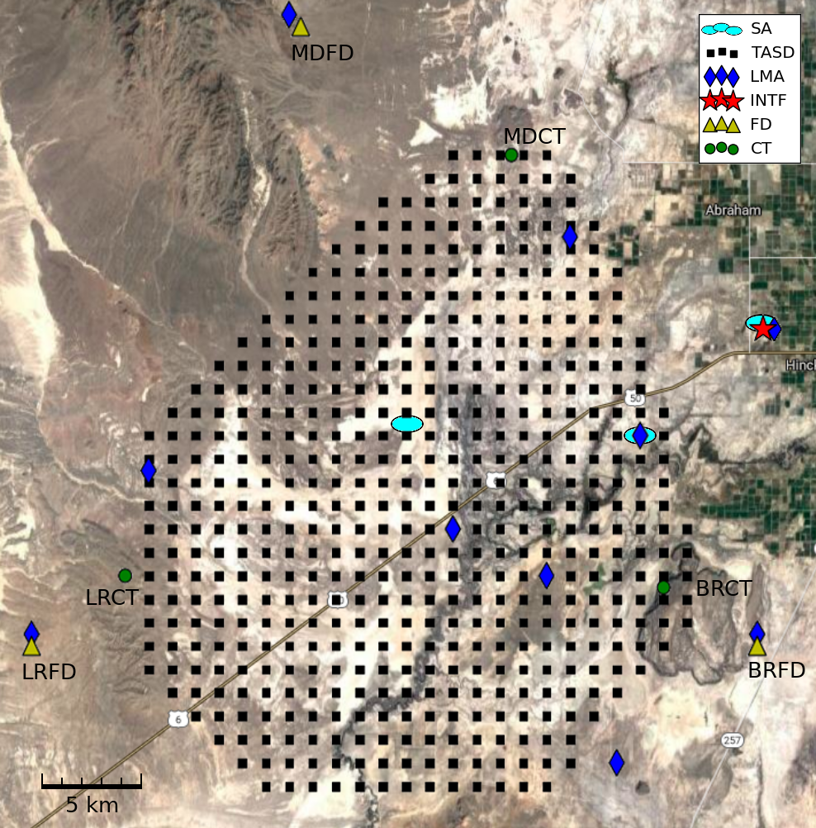
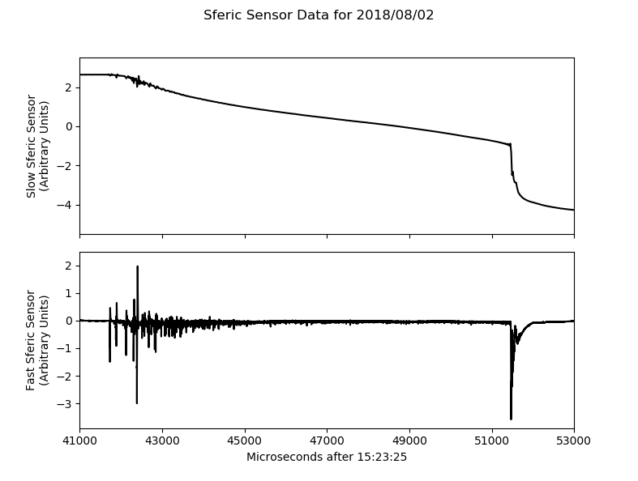
Instrumentation:
Lightning Detectors
Lightning Mapping Array (LMA) locates lightning activity sources in 3D
VHF 60-66 MHz
Sferic sensors measure changes in the local electric field
Slow antennas (SAs) measure overall field development (𝜏 = 10 s)
Fast antennas (FAs) measure quick fluctuations (𝜏 = 100 𝜇s)
Broadband interferometer locates lightning activity sources in 2D, higher resolution
20-80 MHz
Jackson Remington - Thesis Defense - 2021/09/24

Slide 17
Outline
Background of Terrestrial Gamma-ray Flashes (TGFs)
History of TGFs
Thundercloud and lightning anatomy
TGF production and development
Instrumentation
Telescope Array Surface Detectors
Lightning detectors
TGF Observations at Telescope Array
Previous observations 2008-2016
2018 TGFs: observations
2018 TGFs: analysis
2018 TGFs: interpretation
Conclusion
Jackson Remington - Thesis Defense - 2021/09/24

Slide 18
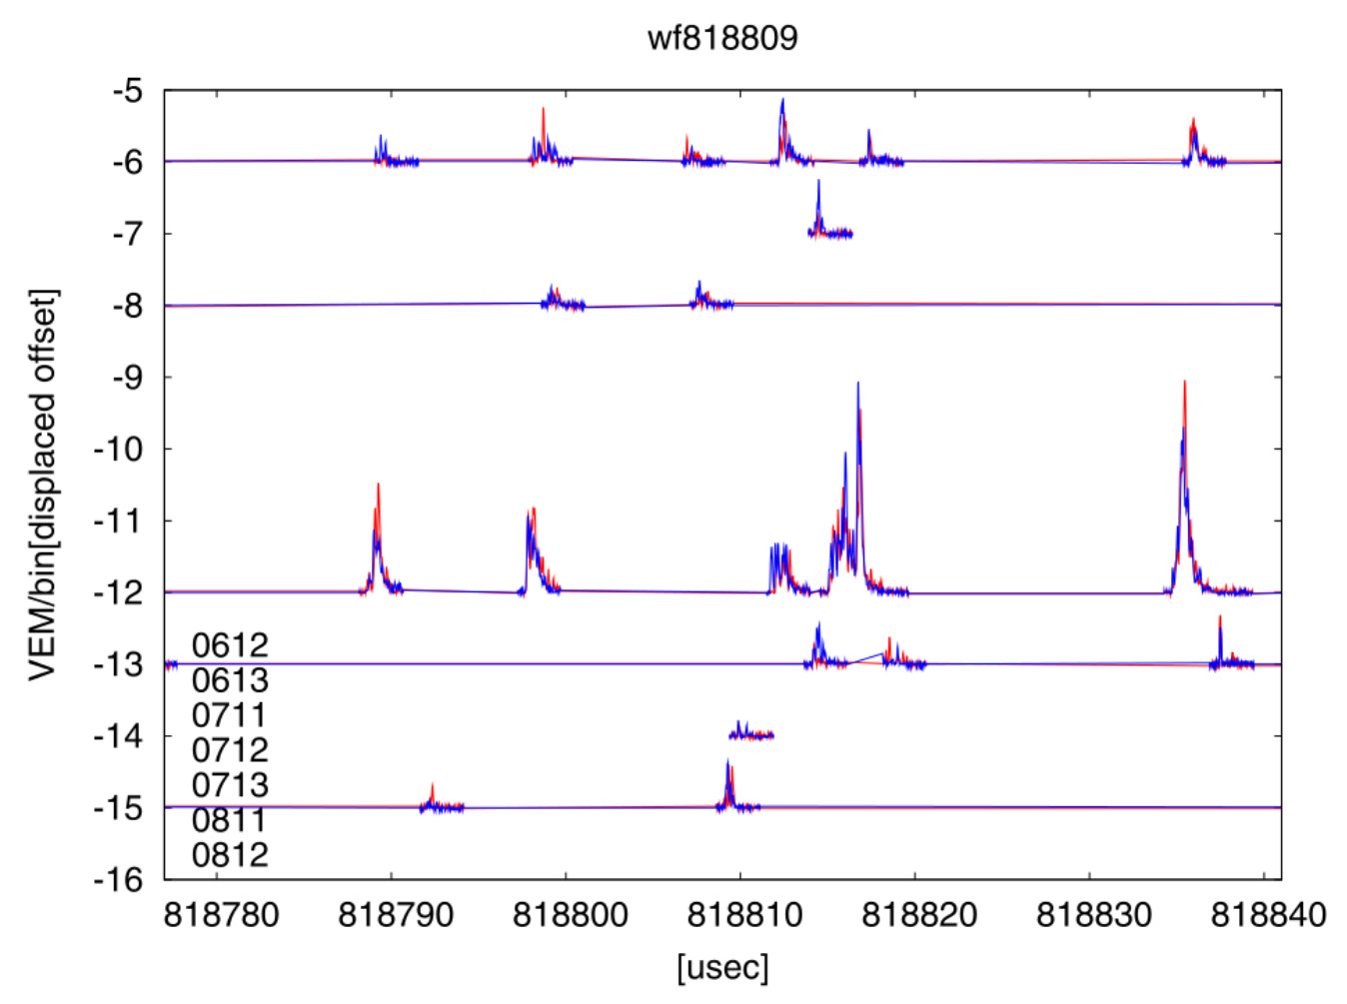
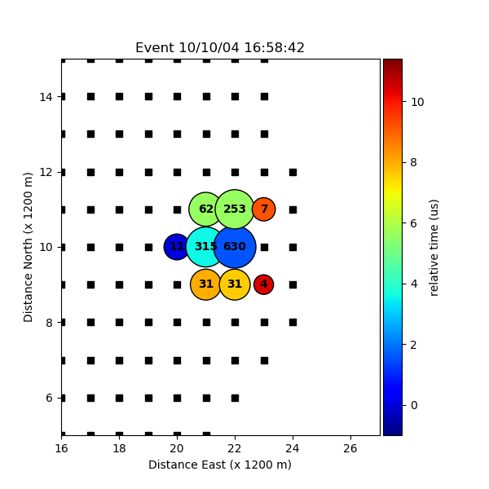
Previous TGF Observations at Telescope Array
2008 - 2013
10 ‘burst’ events defined as triggering TASDs 3+ times within 1 ms
Long, complex signals
Many occur during lightning flashes recorded by National Lightning Detection Network (NLDN)
Nationwide commercial lightning data with ~300 m resolution
Some trajectories point back to NLDN flash locations
T. Okuda
Jackson Remington - Thesis Defense - 2021/09/24

Slide 19
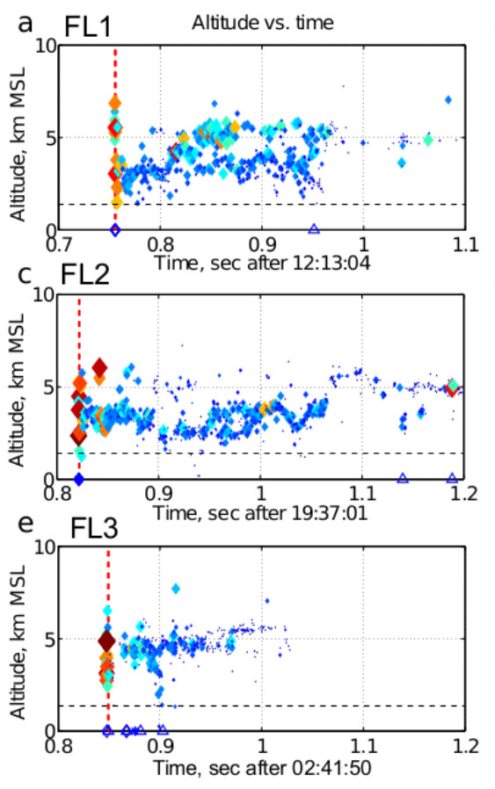
Previous TGF Observations at Telescope Array
2014 - 2016
10 new events after installation of the LMA and slow sferic sensors
Data shows that TGFs are associated with the very early stages of leader development
TGFs arrive in bursts lasting hundreds of microseconds
Jackson Remington - Thesis Defense - 2021/09/24

Slide 20
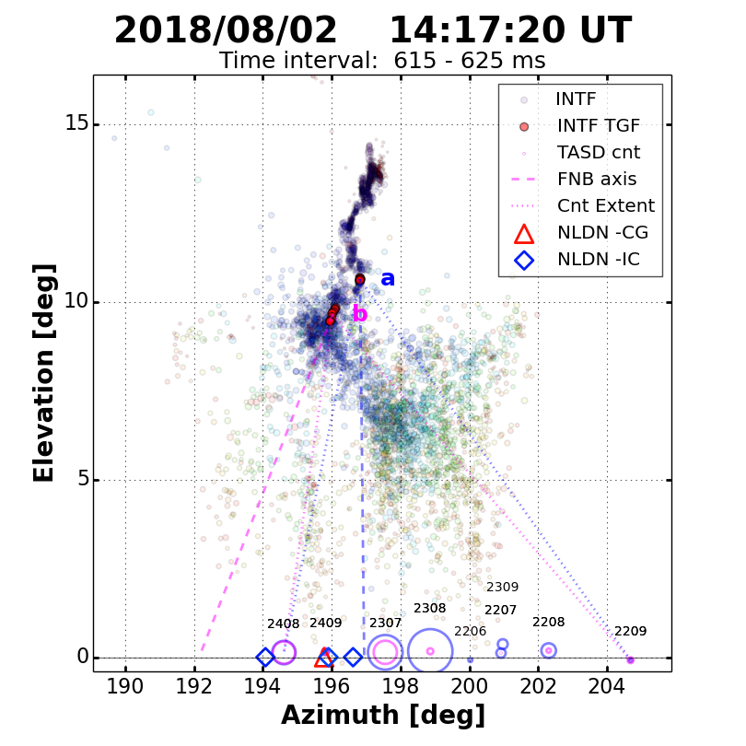
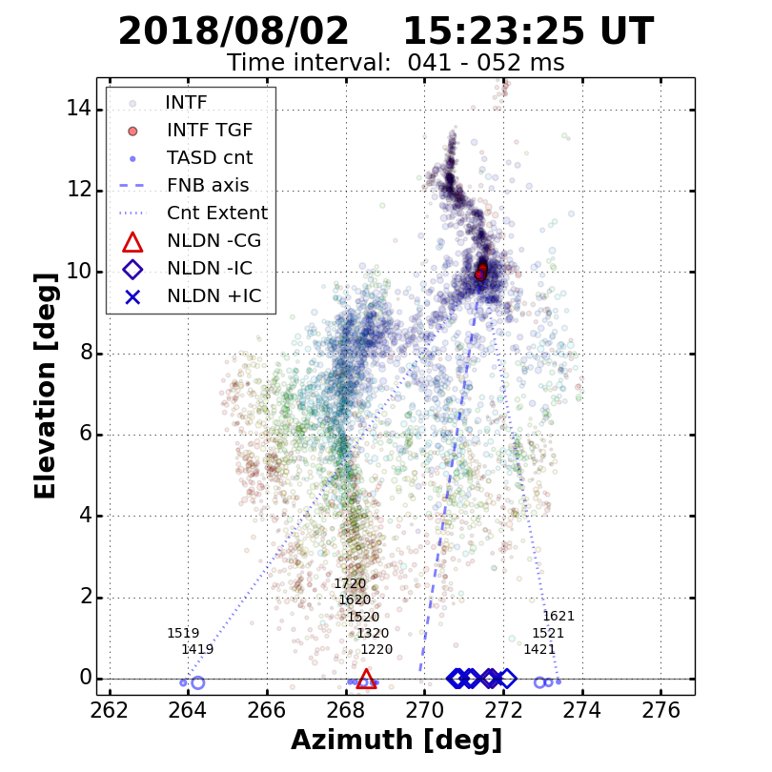
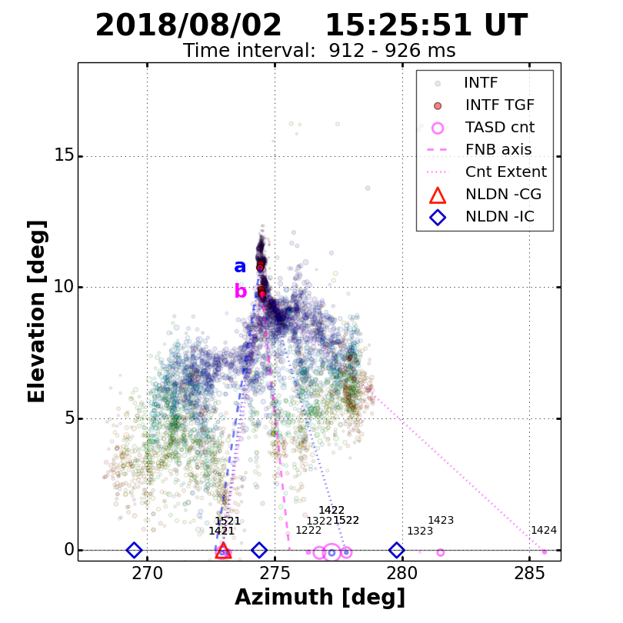
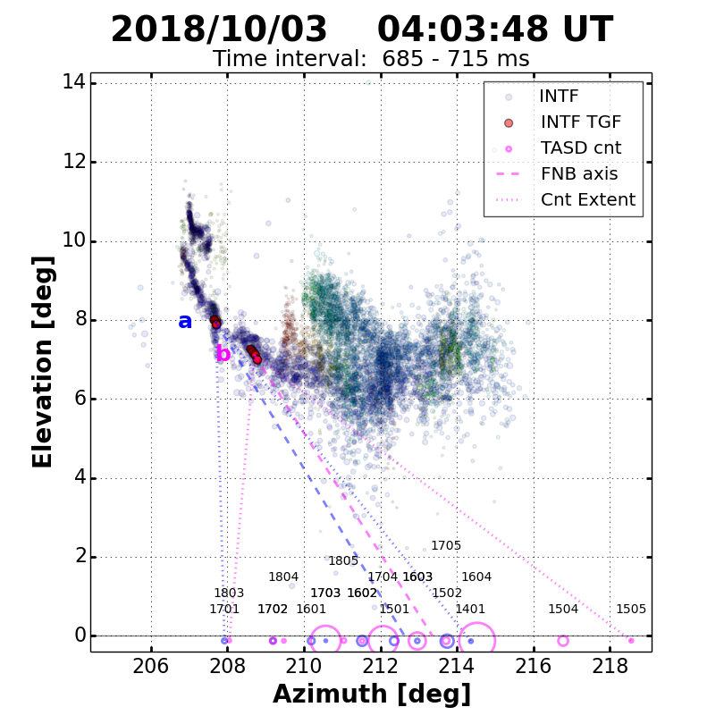
2018 TGFs: Observations
Four TGFs from August-October 2018
TGFs A,C,D consisted of 2 triggers, B was a single trigger.
All four occurred in the first 1-2 ms of downward negative lightning
TGFs A,B,C ended in cloud-to-ground strokes, D was an intracloud flash
A
B
C
D
Jackson Remington - Thesis Defense - 2021/09/24

Slide 21
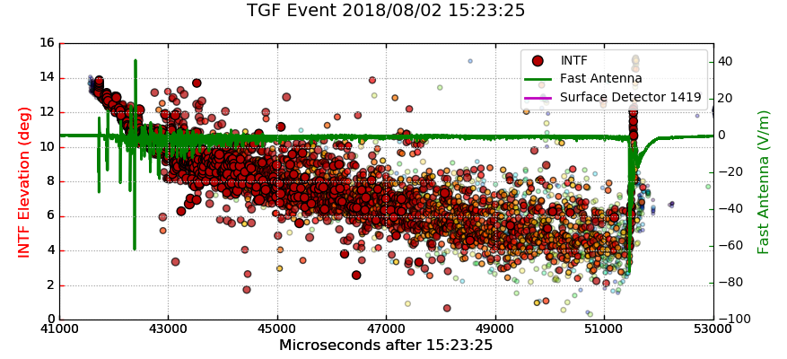
2018 TGFs: Analysis
INTF does not detect the TGF
TASDs do not detect lightning
Propagation delays result in relative timing differences up to 100 𝜇s (a→b vs. a→c)
Goal resolution is 1 𝜇s
TGF altitude depends on source time, which depends on altitude, etc.
Jackson Remington - Thesis Defense - 2021/09/24

Slide 22
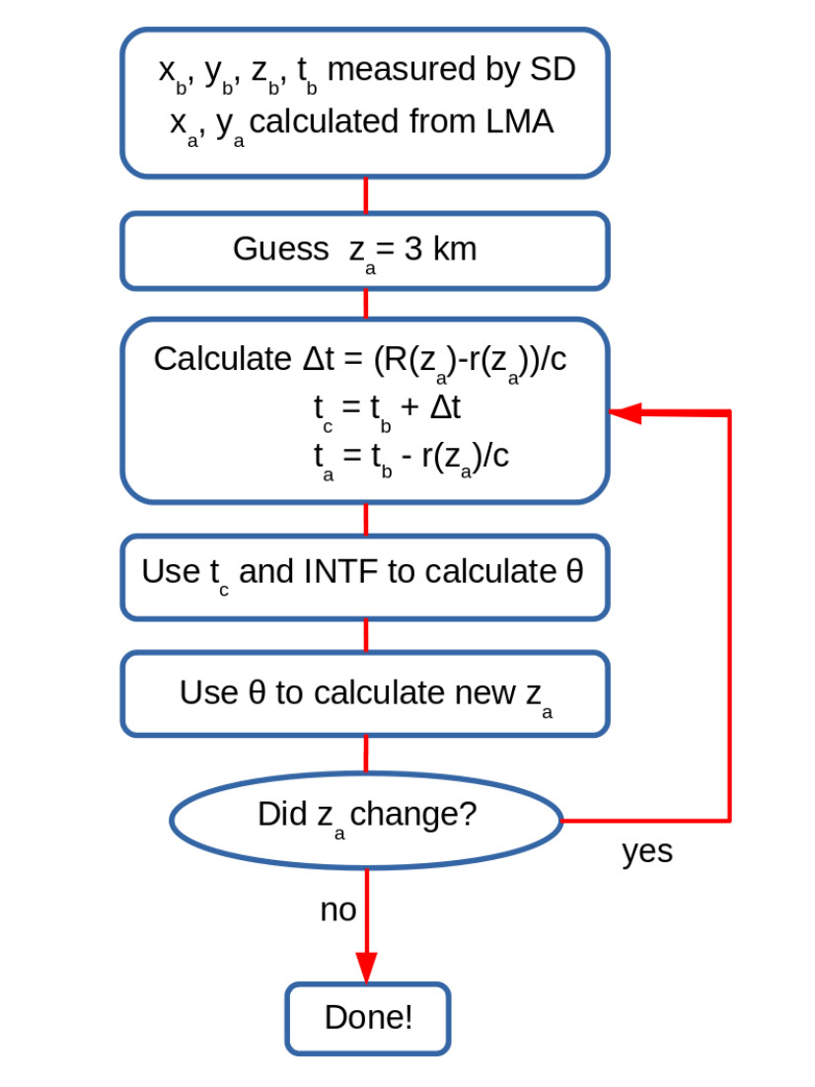
2018 TGFs: Analysis
Resulting average errors:
Horizontal (x,y): 140 m
Vertical (z): 25 m
Timing (t): 0.6 𝜇s
Numerical methods for solving z(t(z)):
Step through INTF data points
Iterate over possible solutions
Jackson Remington - Thesis Defense - 2021/09/24

Slide 23
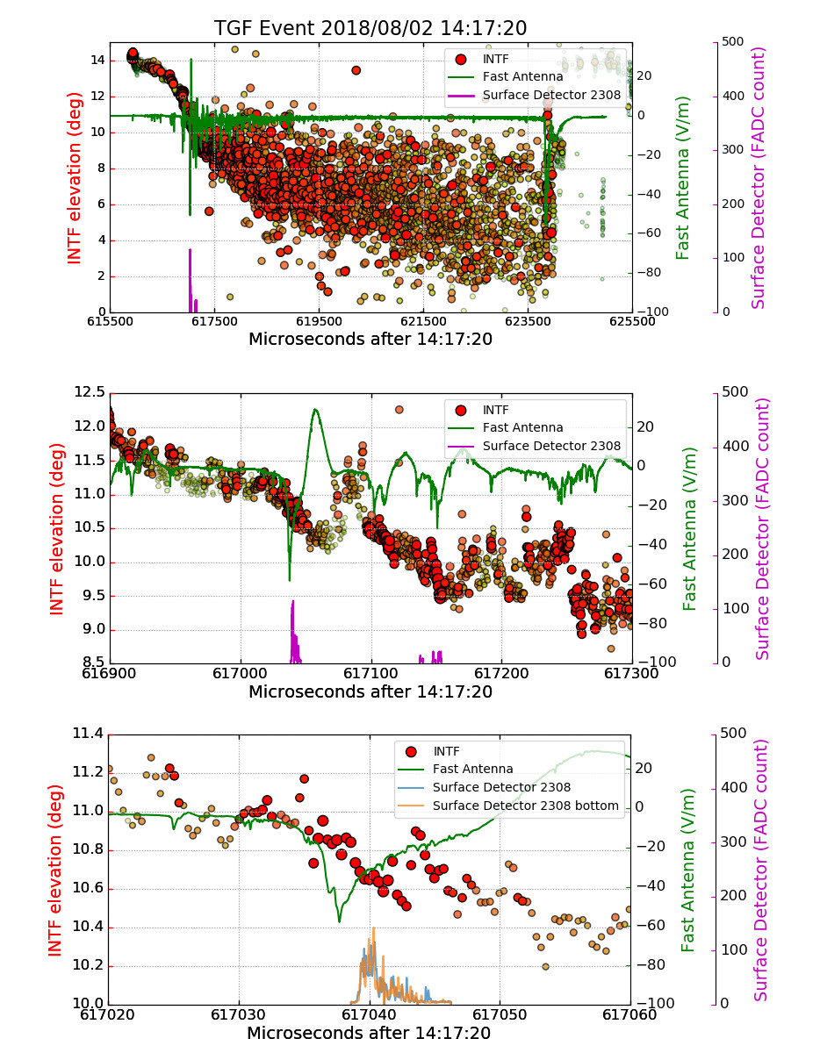
2018 TGFs: Results
Propagation delays removed - TASD, INTF, and sferic data can be directly compared
First ground observations of IBPs and TGFs
The IBPs and TGFs occur during strong leader steps
Timing resolution < 1 𝜇s can identify IBP substructure and breakdown processes
Jackson Remington - Thesis Defense - 2021/09/24

Slide 24
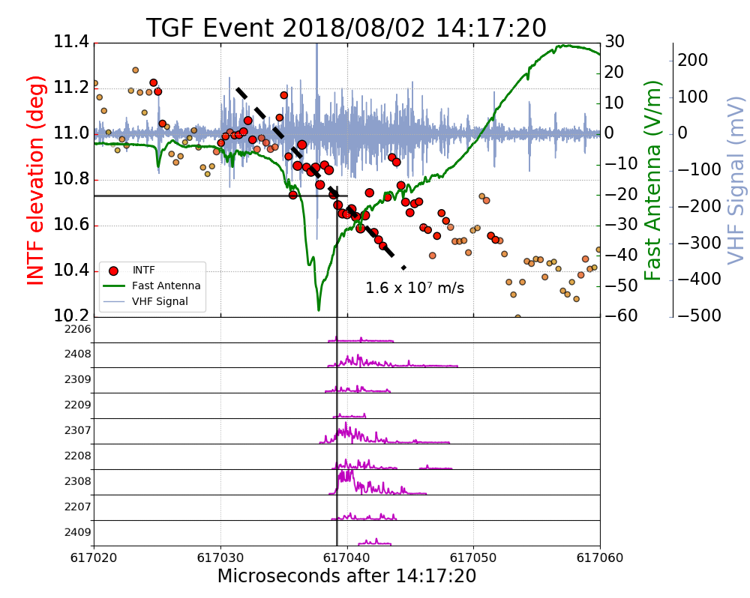
2018 TGFs: Results
Strongest burst of each TGF occurs during the strongest IBP
Leader step development is faster, stronger, and more linear
Power and speed of leader propagation indicates fast negative breakdown (FNB)
IBPs also have strong sub-pulses, sometimes correlated with TGF production
Step discontinuity in leader propagation during each TGF onset
Jackson Remington - Thesis Defense - 2021/09/24

Slide 25
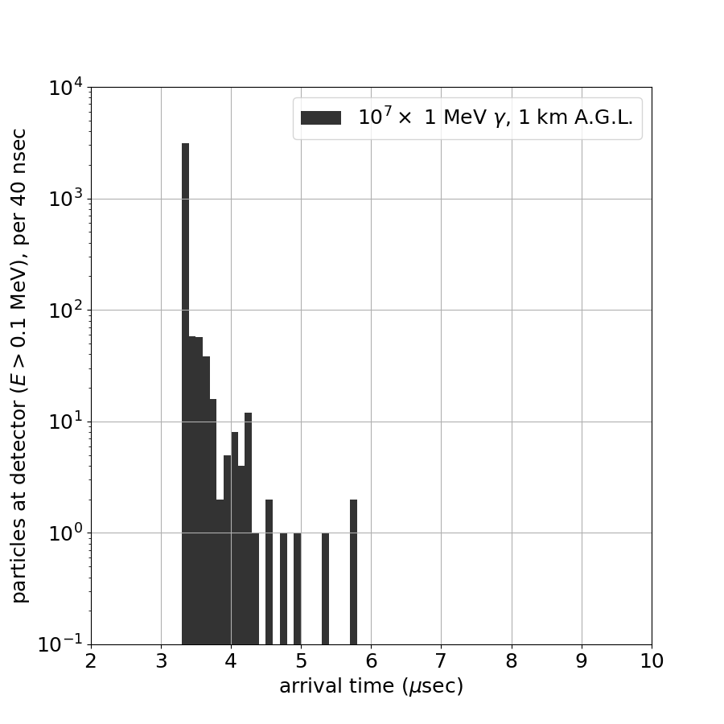
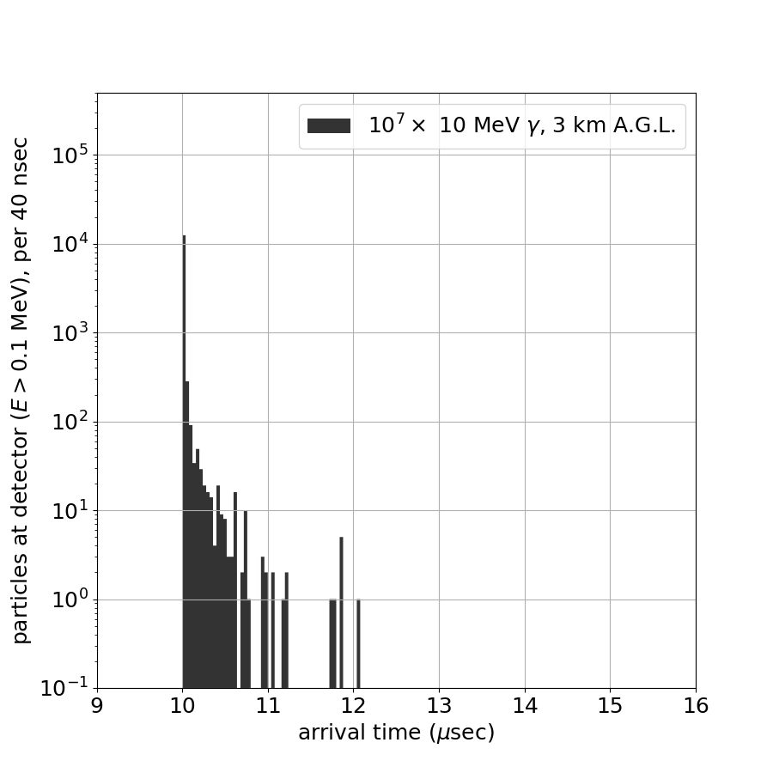
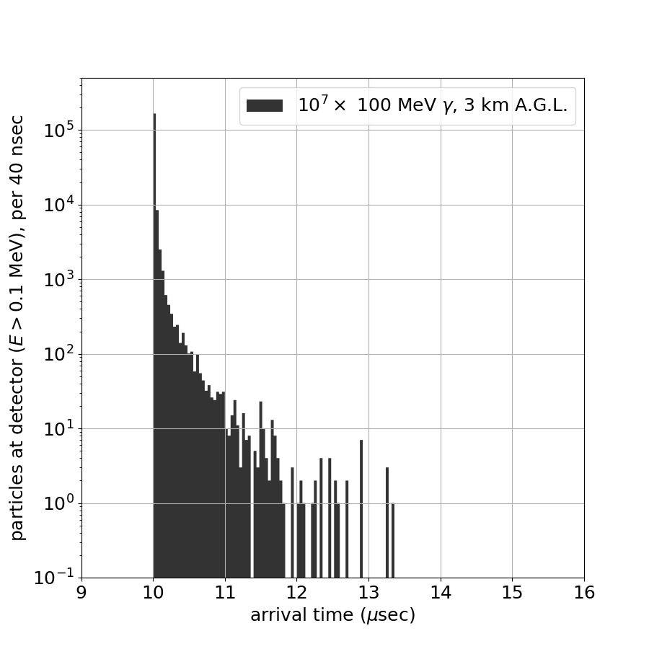
2018 TGFs: Interpretation
Downward TGFs are produced during strong IBPs and periods of FNB in the early leader steps of downward negative lightning
TGF sources have durations of ~3-8 𝜇s, continuing until FNB dies out
Simulations show that the signal durations at the ground reflect the true durations of the source
95% of particles from an instantaneous source arrive in 60 ns
Since FNB is a streamer-based process, these results support the cold runaway model of TGF production
Advancing streamer systems enhance local electric fields to the point of seeding RREA
Photon arrival times from an instantaneous source
(data by Ryan LeVon)
TGF seeding by cold runaway during leader stepping
Jackson Remington - Thesis Defense - 2021/09/24

Slide 26
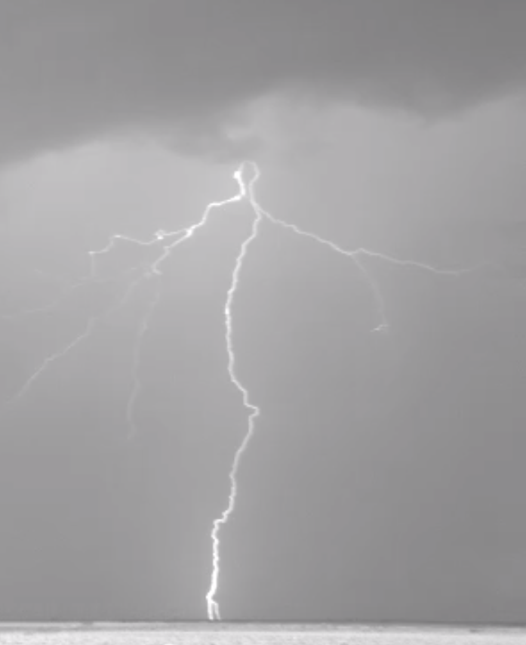
Outline
Background of Terrestrial Gamma-ray Flashes (TGFs)
History of TGFs
Thundercloud and lightning anatomy
TGF production and development
Instrumentation
Telescope Array Surface Detectors
Lightning detectors
TGF Observations at Telescope Array
Previous observations 2008-2016
2018 TGFs: observations
2018 TGFs: analysis
2018 TGFs: interpretation
Conclusion
Jackson Remington - Thesis Defense - 2021/09/24

Slide 27
Conclusion
The observations at Telescope Array constitute a significant portion of all downward TGFs
These downward TGFs...
are produced in the first 1-2 ms of downward negative lightning at altitudes of 2.8-3.2 km
are produced during strong IBPs and streamer-based FNB, supporting the cold runaway model of TGF production
individually last <10 𝜇s, but can occur in sequences spanning up to 500 𝜇s
produce showers at ground level having diameters 3-5 km, corresponding to half-opening angles of 25-40°
are consistent with simulated showers consisting of 10¹²-10¹⁴ photons, with evidence of some gamma-rays having at least 6.4 MeV
Future investigations:
Increase resolution with a second interferometer for stereo measurements
Installed 2020
Additional lightning detector upgrades
Electric field mill installed 2021
High-speed optical camera installed 2021
Investigate differences between upward and downward TGFs
Downward TGFs have shorter duration, smaller fluence
Multi-messenger TGFs?
Jackson Remington - Thesis Defense - 2021/09/24

Slide 28
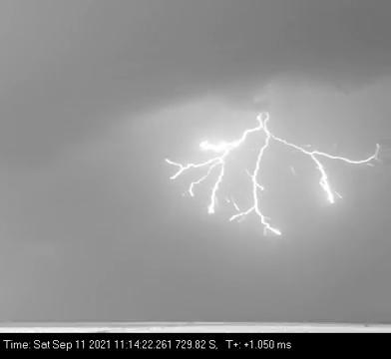
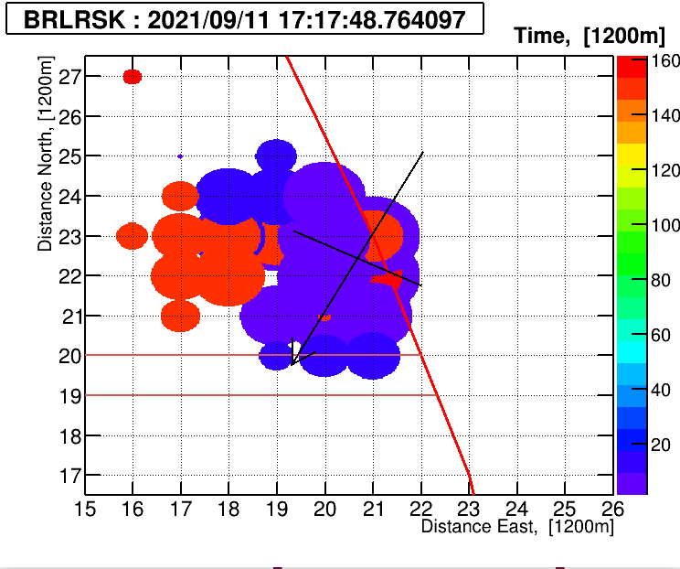
2021/09/11 Flash
~6 km footprint diameter
> 16 GeV in one TASD
Leader speed ~2.6 x 10⁶ m/s (2 ms)
Jackson Remington - Thesis Defense - 2021/09/24

Slide 29
TGF Publications
Telescope Array Publications
Observation of the Origin of Downward Terrestrial Gamma-ray Flashes
J. Belz, et al. (2020). JGR: Atmos, 125 https://doi.org/10.1029/2019JD031940
Gamma-ray Showers Observed at Ground Level in Coincidence With Downward Lightning Leaders
R Abbasi, et al. (2018). JGR: Atmos, 123 https://doi.org/10.1029/2017JD027931
The Bursts of High Energy Events Observed by the Telescope Array Surface Detector
R. Abbasi, et al. (2017). Phys. Lett. A, 381 https://dx.doi.org/10.1016/j.physleta.2017.06.022
Search for Large-scale Anisotropy on Arrival Directions of Ultra-high-energy Cosmic Rays Observed with the Telescope Array Experiment
R. Abbasi, et al. (2020). Astrophys. J. Lett., 898 https://doi.org/10.3847/2041-8213/aba0bc
Evidence for a Supergalactic Structure of Magnetic Deflection Multiplets of Ultra-High Energy Cosmic Rays
R. Abbasi, et al. (2020). Astrophys. J., 899 https://doi.org/10.3847/1538-4357/aba26c
Search for Point Sources of Ultra-High-Energy Photons with the Telescope Array Surface Detector
R. Abbasi, et al. (2020). Monthly Notices of the Royal Astronomical Society, 492 https://doi.org/10.1093/mnras/stz3618
Search for Ultra-High-Energy Neutrinos with the Telescope Array Surface Detector
R. Abbasi, et al. (2020). J. Exp. Their. Phys., 131 https://doi.org/10.31857/S0044451020080052
Constraints on the Diffuse Photon Flux with Energies Above 10¹⁸ eV Using the Surface Detector of the Telescope Array Experiment
R. Abbasi, et al. (2019). J. Astropart. Phys., 110 https://doi.org/10.1016/j.astropartphys.2019.03.003
Testing a Reported Correlation Between Arrival Directions of Ultra-High-Energy Cosmic Rays and a Flux Pattern From Nearby Starburst Galaxies Using Telescope Array Data
R Abbasi, et al. (2019). Astrophys. J. Lett., 867 https://doi.org/10.3847/2041-8213/aaebf9
Mass Composition of Ultrahigh-Energy Cosmic Rays with the Telescope Array Surface Detector Data
R Abbasi, et al. (2019). Phys. Rev. D, 99 https://doi.org/10.1103/PhysRevD.99.022002
Study of Muons from Ultrahigh Energy Cosmic Ray Air Showers Measured With the Telescope Array Experiment
R. Abbasi, et al. (2018). Phys. Rev. D, 98 https://doi.org/10.1103/PhysRevD.98.022002
Jackson Remington - Thesis Defense - 2021/09/24

Slide 30
Supplementary Slides

Slide 31
Supplementary Slides
Lightning Leaders
Leader development details
FNB, streamers, and E-field enhancement
EM shower composition
Instrumentation details
Telescope Array Surface Detector (TASD)
Lightning Mapping Array (LMA)
Sferic sensors (SA + FA)
Broadband interferometer (INTF)
2018 TGFs
Error analysis details
Results details
Comparison of upward and downward flashes
Optical camera footage

Slide 32
Stages of Lightning
Leaders are hot, conducting channels of ionized air allowing current to flow
Leader initiate at the sharp corners of ice crystals
Leaders develop discretely in ~50 m steps
TGF production is associated with the leader stage
The bright return stroke(s) occur once the leader creates a pathway between charge regions
Leader stepping process (left)
(a): Electrons concentrate in the leader tip and generate strong fields
(b): Charges separate ahead of the leader and generate streamer systems
(c): The air heats up and becomes fully conducting as a disconnected ‘space stem’
(d): The stem reconnects with the existing leader
(e): Potential transfers to the new leader step and the process repeats

Slide 33
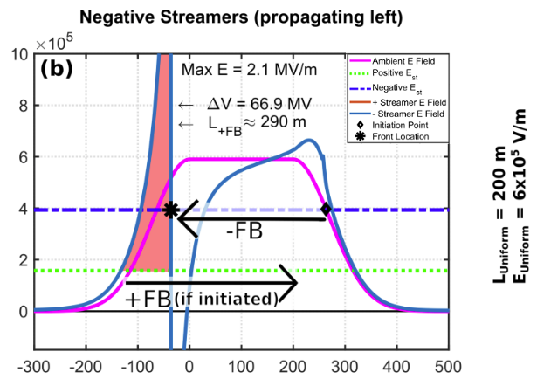
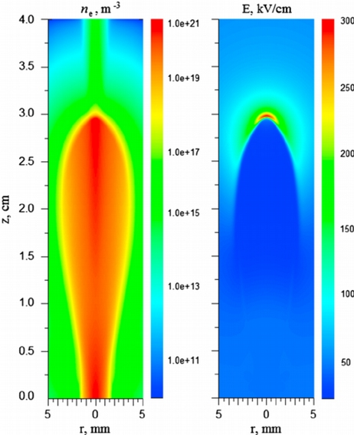
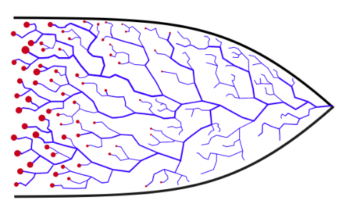
Fast Negative Breakdown (FNB)
Babich, et al. (2015) JGR: Atmospheres 120
Large-scale thunderstorm E field
(RREA Threshold):
~2.8 x 10⁵ V/m
Leader tip E field enhancement
10⁶-10⁷ V/m
FNB E field enhancement x10
~10⁷ V/m
(cold runaway)
Attanasio, A., da Silva, C., Krehbiel, P. (2021). unpublished

Slide 34
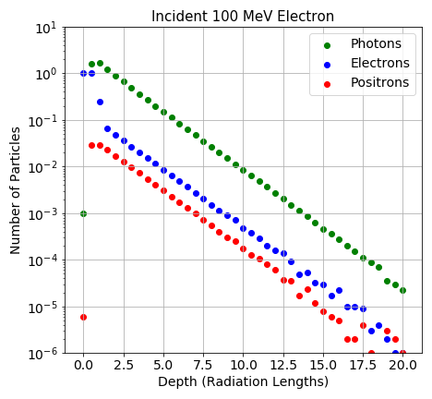
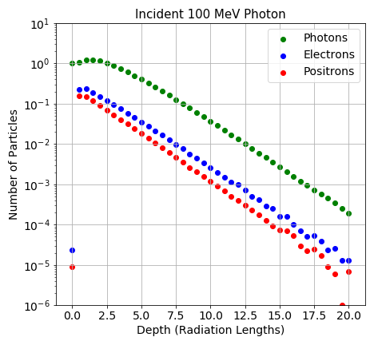
Electromagnetic Showers
Driven EM shower (RREA): ~50% photons ~50% electrons + positrons
Typical EM shower: ~90% photons, ~10% electrons + positrons
Kieran Smout

Slide 35
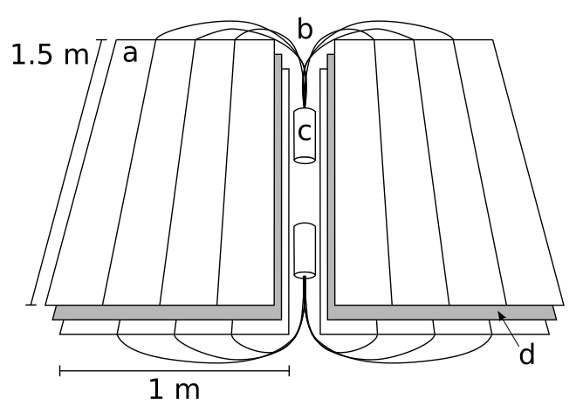
Instrumentation: Telescope Array
507 scintillation detectors (SDs) covering the 700 km² main array
An expansion to 4x size is underway, but data of this study was recorded only on the main array
Fluorescence detectors (FDs) data not used in this study
TASDs contain two layers of plastic scintillator for detecting charged particles.
Energy deposit in the form of fluorescence light is captured for each layer and counted on local electronics.

Slide 36
Instrumentation: TASD RF Interference
FL03: 2016/05/10 02:41:50
Cloud-to-ground lightning stroke only 78 m from TASD 0922 caused pedestal and FADC fluctuations (@ ~13 and 15 𝜇s)

Slide 37
Instrumentation: Lightning Mapping Array (LMA)
11 detectors spread over main TA detecting narrow bipolar events
Installed 2013 by Langmuir Laboratory for Atmospheric Research
Time-of-arrival analysis determines 3D locations of individual sources (a few per ms)
Errors of a similar (larger) array:
40-50 ns in t
10-50 m in x, y
20-100 m in z

Slide 38
Instrumentation: Sferic Sensors
Radio atmospherics (sferics) are RF pulses produced by breakdown activity from 0.1 Hz-10 MHz.
Low signal attenuation means these can be detected from 100s of km range - strongest in VLF 3-30 kHz
Charge is induced on the antenna’s flat plate by varying fields
Plate is discharged via adjustable RC circuit
Current is integrated to obtain a voltage proportional to the applied field
The circuit’s decay time can be adjusted to filter fluctuations 𝝉 = RC
𝝉 = 10 s
𝝉 = 100 𝜇s

Slide 39
Instrumentation:
Broadband Interferometer (INTF)
Similar to the sferic sensors, the INTF collects induced charge and reads the voltage
No RC circuit or integrator, sensitive to VHF impulses 20-80 MHz produced by small-scale breakdown
Identifies 2D source positions (a few per 𝜇s)
Typical errors:
~100 ns in t
~ 0.1° in elv, azi

Slide 40
2018 TGFs: Analysis Errors
Coordinates of TGF sources are determined by four measurements:
x, y (LMA) standard error of all LMA points within ±1 ms =
t (TASD) uncertainty in TASD trigger time = 40 ns
z (INTF) standard error of INTF points within ±4 𝜇s =
Standard error can be propagated
through iterative method using:
Resulting average errors:
Horizontal (x,y): 140 m
Vertical (z): 25 m
Timing (t): 0.6 𝜇s
Effect of each measurement on final solution of TGF A

Slide 41
2018 TGFs: Results
Strongest burst of each TGF occurs during the strongest IBP
Leader step development is faster, stronger, and more linear
Power and speed of leader propagation indicates fast negative breakdown (FNB)
IBPs also have strong sub-pulses, sometimes correlated with TGF production
Step discontinuity in leader propagation during each TGF onset

Slide 42
2018 TGFs: Comparison to upward flashes
Downward TGF-producing cloud-to-ground flash
Downward TGFs consist of 10¹²-10¹⁴ photons
Durations of 5-10 𝜇s
Upward intracloud flash ~1 minute later
Upward TGFs consist of 10¹⁵-10¹⁹ photons
Durations of 20-200 𝜇s

Slide 43
2018 TGFs: Comparison to upward flashes
Downward leader steps (0-5 km)
Step lengths 3-50 m
Durations of 5-50 𝜇s
Average speeds 1-30 x 10⁵ m/s
(Malan et al. (1935))
Upward leader steps (10 km)
Step lengths >200 m
Durations of ~4 ms
Average speeds ~10⁴ m/s
(Edens et al. (2014)

Slide 44
Optical Camera - Positive Cloud-to-ground Flash
Phantom V2012
40,000 FPS
Aug. 18, 2021
10:25:50 UTC

